Slide 1



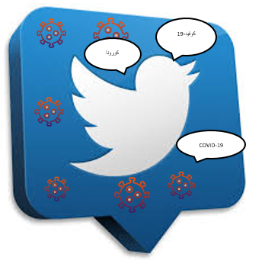
COVID-19 and Arabic Twitter: How can Arab World Governments and Public Health Organizations Learn from Social Media?
Lama Alsudias Dr. Paul Rayson

Slide 2
Introduction
Governments around the world have taken different decisions in order to stop the spread of COVID-19 .
People use social media applications such as Twitter to find the news related to COVID-19 and/or express their opinions and feelings about it.
We hypothesise that Governments and Public Health Organizations (PHOs) may benefit from mining the topics discussed between people during the pandemic.
The Arabic language is spoken by 467 million people in the world and has more than 26 dialects¹ .

Slide 3
Introduction (Continued)
In this paper, we have combined qualitative and quantitative studies to analyse Arabic tweets aiming to support Public Health Organizations who can learn from social media data along various lines:
Analyzing the topics discussed between people during the peak of COVID-19.
Identifying and detecting the rumours related to COVID-19.
Predicting the type of sources of tweets about COVID-19.

Slide 4
Update Arabic Infectious Disease Ontology
With the recent appearance of COVID-19 as a new disease, there is a need to update our Arabic Infectious Disease Ontology ² , which integrates the scientific and medical vocabularies of infectious diseases with their informal equivalents used in general discourse.
This included symptom, cause, prevention, infection, organ, treatment, diagnosis, place of the disease spread, and slang terms for COVID-19 and extended our ontology.
These terms were then used in our collection process.

Slide 5
Data Collection
When?
We analysed the tweets related to COVID-19 from December 2019 to April 2020.
How many?
We have collected approximately six million tweets in Arabic during this period.
What?
We obtained the tweets depending on three keywords (كورونا), (كرونا), and (كوفيد-19), which mean Coronavirus, a misspelling of the name of Coronavirus, and COVID-19 respectively in English.
How?
We collected the tweets weekly using Twitter API.

Slide 6
Data Pre-processing
Manually remove retweets, advertisements, and spam.
Filter out URLs, mentions, hashtags, numbers, emojis, repeating characters, and non-Arabic words using Python scripts.
Normalize and tokenize tweets.
Remove Arabic stopwords.

Slide 7
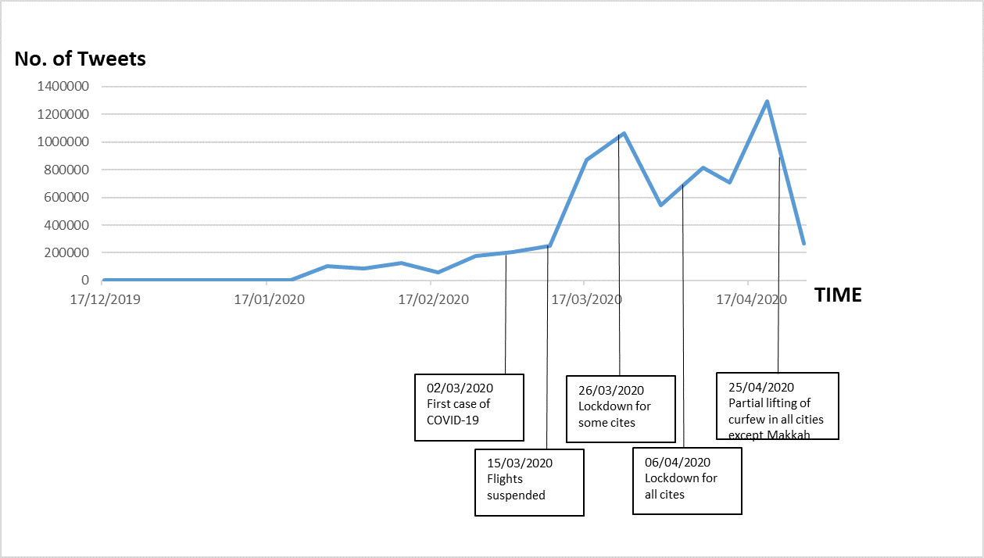
Dataset
The resulting dataset was 1,048,576 unique tweets from the original 6,578,982 collected.

Slide 8
Methods
We performed three different types of analysis on the collected data.
To better understand the topics discussed in the corpus
We carried out a cluster analysis
To detect rumours
We took a sample of the corpus, then classified the tweets
To determine the veracity of the tweets.
We extended our previous work to classify the source of tweets into five types of Twitter users

Slide 9
Cluster Analysis
To explore the topics discussed on Twitter during the COVID-19 epidemic in Saudi Arabia and other countries in the Arab World, we subjected the text of the tweets to cluster analysis.
After pre-processing the tweets as described above, we used the N-gram forms (unigram, bigram, and trigram) of twitter corpus.
We clustered them using the K-means algorithm with the Python Scikit-learn software and set the value of k, the number of clusters, to be five.

Slide 10
Rumour Detection
We applied a top-down strategy, which is where the set of rumours is identified in advance then the data is sampled to extract the posts associated with the previously identified rumours.
In our dataset, out of the one million tweets, we sampled 2,000 tweets to classify them for rumour detection. We manually labelled the tweets to create a gold standard dataset and then applied different machine learning algorithms in this part of our study.

Slide 11
Labelling Guidelines
Rumour in Arabic | Rumour in English
الحيوانات الأليفة تنقل فيروس كورونا. | Pets are transporters of Coronavirus.
البعوض ناقل لكورونا. | Mosquitoes are transporters of Coronavirus.
الأطفال قد لا يصابون بفيروس كورونا. | Children are not infected by Coronavirus.
كبار السن فقط قد يتعرضون لمخاطر سيئة من فيروس كورونا. | Only old people may have a high risk of Coronavirus.
حرارة الطقس أو برودته تقضي على الفيروس. | Hot or cold weather can kill the virus.
الغرغرة بالماء والملح تقضي على الفيروس. | Gargling with water and salt eliminates the virus.
الفيروس لا يبقى على الأسطح. | There are some herbs that protect against from Coronavirus.

Slide 12
Example Tweets
Tweet in Arabic | Tweet in English | Label
سيكون هناك انحسار لانتشار فيروس كورونا مع بداية فصل الصيف خصوصا في العالم العربي نظرا لارتفاع درجة الحرارة. | There will be a decrease in the spread of the Corona virus at the beginning of the summer, especially in the Arab world, due to the high temperatures. | 1 (false)
الصحة: يعيش الفيروس ويرتكز بالأساس في الجهاز التنفسي لذلك غير وارد انتقاله عن طريق الحشرات أو من خلال لدغة البعوض. | The Ministry of Health: A virus lives and is mainly concentrated in the respiratory system, so it is not likely to be transmitted by insects or by mosquito bites. | -1 (true)
اللهم في هذي الساعة المباركة نسألك أن ترحمنا وتبعد عنا كل داء وبلاء وقنا شر الأمراض والأسقام واحفظ بلادنا وكافة بلاد المسلمين. | Oh God, in this blessed hour, We ask you to have mercy on us and keep away from us all disease and calamity, and protect us from the evil of diseases and sicknesses. Preserve our country and other Muslim countries. | 0 (unrelated)

Slide 13
Machine Learning Models
We applied three different machine learning algorithms: Logistic Regression (LR), Support Vector Classification (SVC), and Naïve Bayes (NB).
To help the classifier distinguish between the classes more accurately, we extracted further linguistic features.
The selected features fall into two groups: word frequency, count vector and TF-IDF, and word embedding based (Word2Vec and FastText).
We used 10-fold cross validation to determine accuracy of the classifiers for this dataset, splitting the entire sample into 90% training and 10% testing for each fold.

Slide 14
Source Type Prediction
We replicated a Logic Regression model from our previous study, which was useful for classifying tweets into five categories: academic, media, government, health professional, and public ³.
We used this LR model because it previously achieved the best accuracy (77%), and employed it here to predict the source of the COVID-19 tweets that we had already labelled.

Slide 15
Results and Discussion (Cluster Analysis)
Statistics
Prayers
اللهم اصرف عنا الوباء وقنا شر الداء بلطفك ورحمتك إنك على كل شيء قدير
God, distract us from the epidemic, and grant us the evil of sickness with your kindness and mercy. You are capable of everything
Locations
أمانة الرياض تنفذ أعمال تطهير وتعقيم للطرقات الرئيسية والفرعية والمنشآت لمنع انتشار كورونا
Advising
وزارة الصحة : تسجيل ١٥ حالة شفاء و ١٢٨ إصابة جديدة بفيروس كورونا المستجد
Ministry of Health: 15 new cases of recovery and 128 new cases of coronavirus were registered
التباعد الاجتماعي.. وقاية من كورونا.. ابقوا في منازلكم
Social spacing ... protection from corona ... stay in your homes
Discount coupons for all major online stores
كوبونات خصم لجميع المتاجر الالكترونيه الكبرى
The Riyadh Municipality carries out purification and sterilization works for the main and secondary roads and establishments to prevent the spread of Corona
Advertising

Slide 16
Results and Discussion (Rumour Detection)
Figure: Results using Logistic Regression

Slide 17
Results and Discussion (Source Type Prediction)
Tweet in Arabic | Tweet in English | Predicted Label
في قراءة علمية... يتوقع اندثار الفيروس في ابريل بسبب الحرارة. | In scientific reading ... the virus is expected to erode in April due to heat. | Academic
متحدث الصحة الحالات المؤكدة حتى الآن المصابة بفيروس كورونا ومعضمها لبالغين. | Health spokesman has confirmed cases so far infected with coronavirus, mostly for adults. | Media
يا وزارة رشوا البعوض، هو الناقل لفيروس كورونا زادت الإصابات مع انتشار البعوض. | Ministry of health please spray mosquitoes, as they are carriers of the Coronavirus, increased infections as mosquitoes spread. | Government
خبير صيني يؤكد أن استنشاق بخار الماء يقتل فيروس كورونا. | A Chinese expert confirms that inhaling water vapor kills coronavirus. | Health professional
علاج الكرونا بالليمون والثوم "رابط يوتيوب". | Corona treatment with lemon and garlic "YouTube link". | Public

Slide 18
Conclusion
In this paper, we identified and analysed one million tweets related to the COVID-19 pandemic in the Arabic language.
We performed three experiments which we expect can help to develop methods of analysis suitable for helping Arab World Governments and Public Health Organisations.
The clustered topics are COVID-19 statistics, prayers for God, COVID-19 locations, advise for preventing education, and advertising.
Our second contribution is a labeled sample of tweets (2,000 out of 1 million) annotated for false information, correct information, and unrelated.
Around 60% of the rumour related tweets are classified as written by health professional and academics which shows the urgent need to respond to such fake news.

Slide 19
Future work
There are clearly many potential future directions related to analysing social media data on the topics of pandemics.
Since false information has the potential to play a dangerous role in topics related to health, there is a need to enhance and automate the automatic detection process supporting different languages beyond just English.
Future potential directions include monitoring the spread of the disease by finding the infected individuals, defining the infected locations, or observing people that do not apply self isolation rules.
Moreover, the analysis could proceed in an exploratory and thematic way such as discovering further topics discussed during the epidemic, as well as assisting governments and public health organisations in measuring people's concerns resulting from the disease.

Slide 20
Thank You!
If you have questions or feedback, please send to: l.alsudias@lancaster.ac.uk

