Slide 1
CATCHPlus
Valorisation project for CATCH research programme.
Public funding
But: development mainly by commercial parties
Open source required
Cultural Heritage Institutions. Involved in OpenSKOS:
Cultural Heritage Agency of the Netherlands
Sound and Vision
National Archive
To some extent: Meertens, KB, RKD
Companies. Involved in OpenSKOS:
Adlib
Trezorix
Pictura
Notes:
Gedurende half jaar intensief overlegd door CATCHPlus, RCE, Adlib, Pictura, Trezorix
Op initiatief van en gehost door RCE
Mede naar aanleiding van VAS, versie 1
Doel: elkaars tools en omgevingen op elkaar aansluiten mbt vocabulaires/kennisstructuren
Uitkomst: architectuur-concept en REST API specificatie
OpenSKOS implementatie is helemaal conform de uitkomsten van dit overleg

Slide 2
Problem statement
Construction and maintenance of vocabularies is time consuming
Reuse is preferred
How to discover and evaluate existing vocabularies?
CH vocabularies are often published as browsable and searchable web sites only
Not as data, not in standard form
Software tools have to be adapted for each (version of each )specific vocabulary

Slide 3
The “vision”

Slide 4
OpenSKOS
OpenSKOS =
SKOS format +
Peer to peer architecture +
RESTful API +
Linked Data +
Publication with upload and OAI-PMH +
Management using Interactive Dashboard +
Support for alignment +
Promotion of open database licenses
And lately, vocabulary curation with built-in editor

Slide 5
SKOS, an ultra short primer
Simple Knowledge Organization System
SKOS knowledge structures consist of Concepts grouped in ConceptSchemes
Concepts are identified by a URI
Concepts have labels in 1 or more languages
Concepts can be documented with ‘notes’
Concepts have mutual semantic relations
broader, narrower, related
Concept in different ConceptSchemes can have matching relations

Slide 6
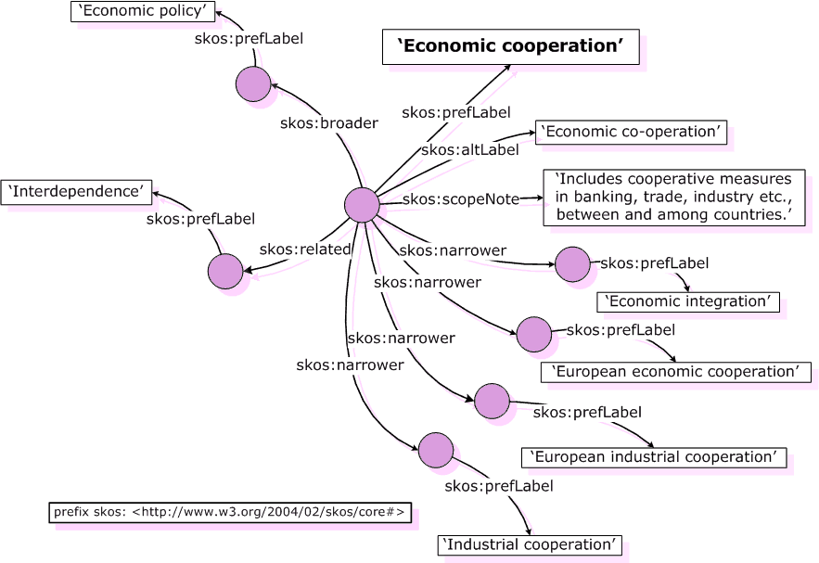
Notes:
Korte SKOS recapitulatie:
Links: termgebaseerd
Rechts: conceptgebaseerd (waarbij de termen labels zijn, gekoppeld aan concepten)
Term-> prefLabel
Used for -> altLabel
Broader, narrower term -> broader, narrower concept
etc

Slide 7
Advantages for providers
Publish your vocabularies or updates yourself with a simple upload action (or via periodic harvesting)
Use your own vocabularies in somebody elses tool (commercial or non-commercial) without intervention of the tool builder
Easy to align your own concepts with other vocabularies

Slide 8
Advantages for users
Simple to discover, evaluate and use vocabularies
Less need to construct them yourself
New browsing and searching possibilities
In vocabularies, in metadata descriptions
Online vocabularies are always up to date

Slide 9
Advantages for tool builders
No customization per (version of a) vocabulary needed
Can benefit from work of other tool builders and vocabulary providers
Potential for a range of new use cases
Notes:
Like: (collaborative) management, openskos as topic map for collections

Slide 10
Demo
Each node implements:
Dashboard/Editor for interactive access
Upload module
RESTful API
Linked Data access
OAI-PMH data provider and harvester

Slide 11
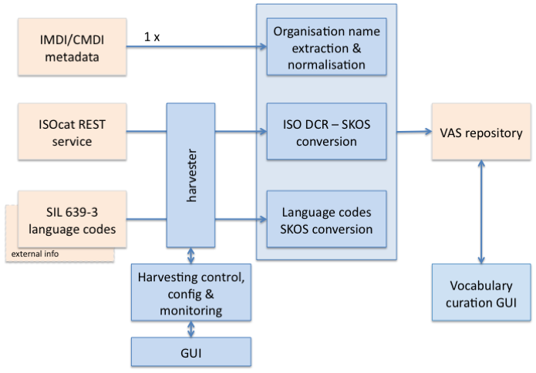
CLARIN-NL: CLAVAS
OpenSKOS

Slide 12
Linked Data | OpenSKOS | ISOcat
Generic | ←→ | Domain specific
Links! | Specific relations | No relations
Publication | Publication & management | Standardization & registration
Generic data | Terminology | Terminology
Long term lists | Long term lists
Resolve | RESTful service (incl resolve) | RESTful service (incl resolve)
 | CRUD operations

Slide 13
Some discussion issues
Distribution raises some untested/unresolved issues
Synchronisation of primary and secondary copies
Identifiers
Content
Add useful vocabularies
Open licences
Curation
Domains of interest
Ideas for pilots, projects, collaborations

Slide 14
Thank you. Questions?

Slide 15
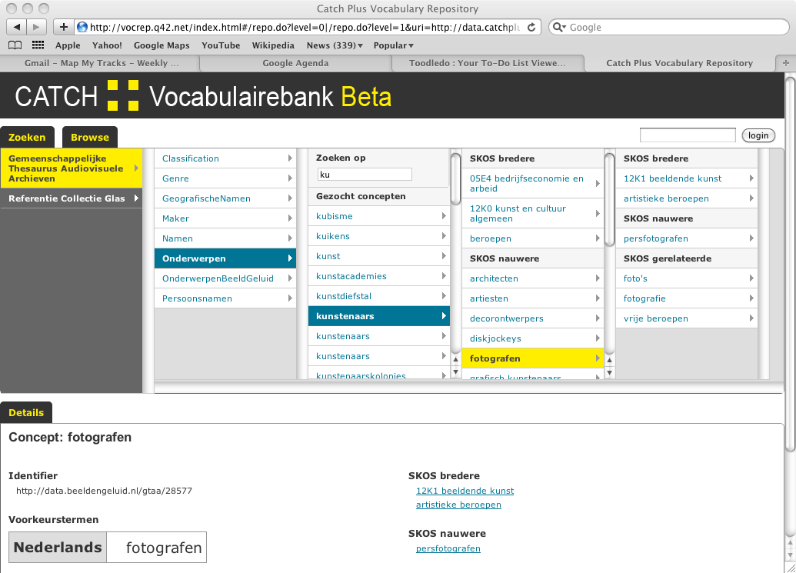

Slide 16
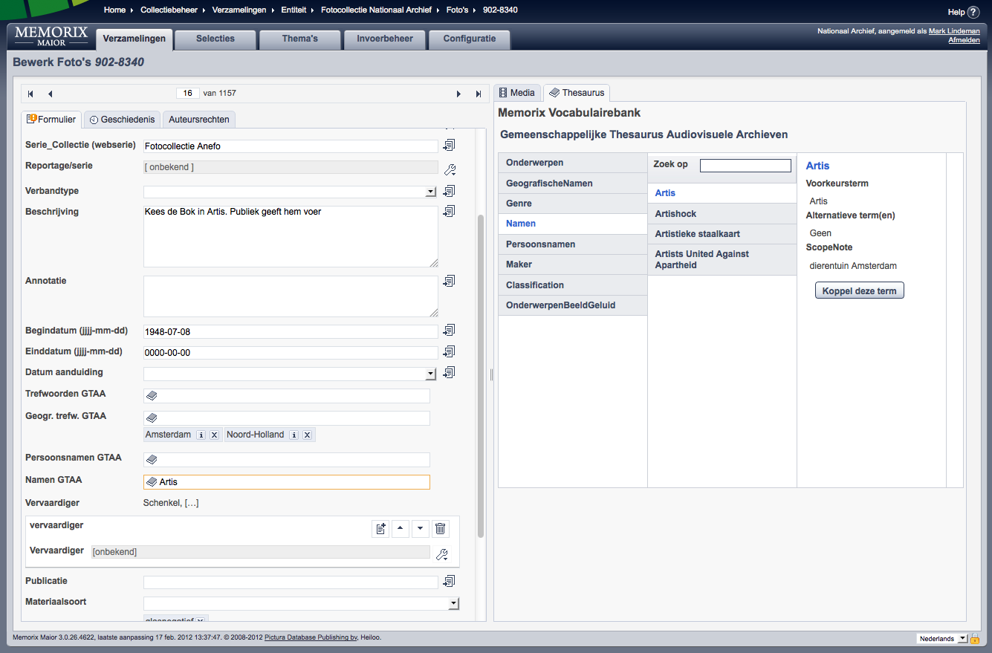

Slide 17
