Slide 1
Fighting the COVID-19 Infodemic:
Modeling the Perspective of Journalists, Fact-Checkers, Social Media Platforms, Policy Makers, and the Society
Firoj Alam, Shaden Shaar, Alex Nikolov, Hamdy Mubarak, Fahim Dalvi,
Nadir Durrani, Hassan Sajjad, Giovanni Da San Martino, Ahmed Abdelali,
Abdulaziz Al-Homaid, Kareem Darwish, Preslav Nakov
Qatar Computing Research Institute, HBKU
CLARIN: Hackathon on COVID-19 Related Disinformation (Virtual Event)
September 21, 2020
Notes:
Tanbih -- “warning”
Al Tanbih: A projected newspaper in Arabic, Al-Tanbih (L'Avertissement), which was planned in 1800 as an instrument of liaison between the French and the local population, whereby the latter would be educated gradually in the ways of the West and the ideals of the Revolution, never saw publication.

Slide 2
The Tanbih
Mega-Project
2

Slide 3

Mission Statement: Limit the effect of “fake news”, propaganda and media bias by making users aware of what they are reading.
3

Slide 4

https://www.tanbih.org/
Highlights:
Disinformation-aware news aggregator
Media profiles: detect the “fake news” before it was even written
Fine-grained propaganda analysis: raising awareness
Fact-checking: check-worthiness, was it checked before (real-time)
Focus on MENA: media, events, languages
APIs, browser plugin, Twitter bot, etc.
4

Slide 5
Try Tanbih: http://www.tanbih.org
5

Slide 6
The COVID-19 Infodemic
6

Slide 7
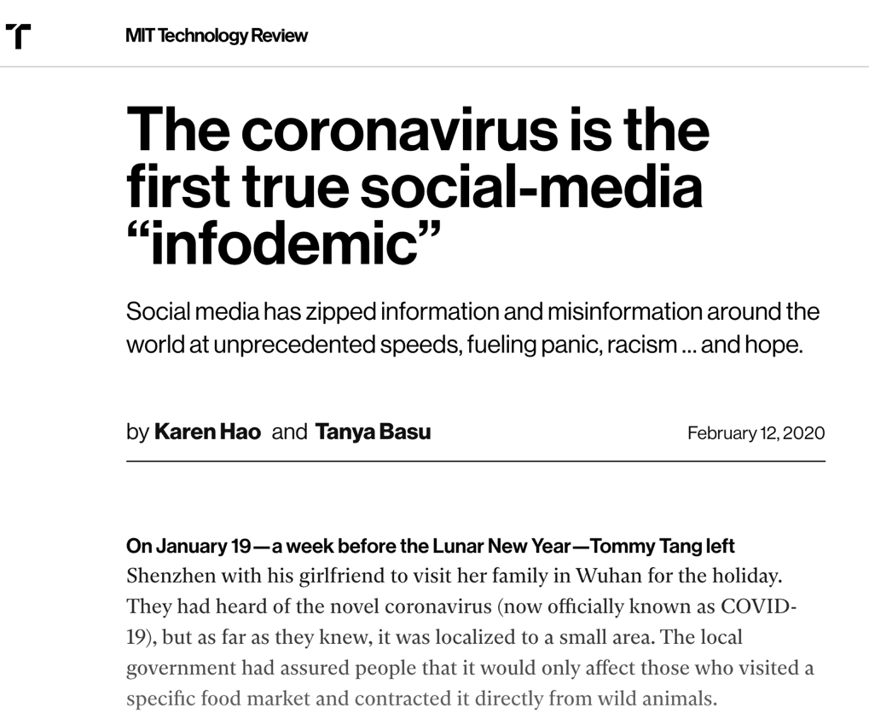
https://www.technologyreview.com/2020/02/12/844851/the-coronavirus-is-the-first-true-social-media-infodemic/
7

Slide 8

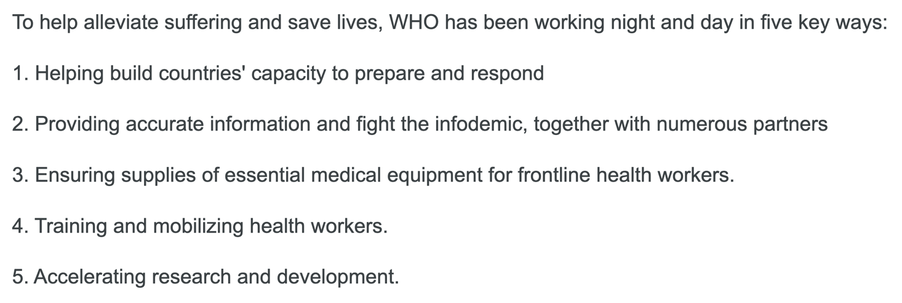
https://www.who.int/emergencies/diseases/novel-coronavirus-2019/events-as-they-happen
8

Slide 9
The Hackaton:
Data and Task
9

Slide 10
Summary
Holistic COVID-19 annotation schema for tweets
Multiple perspectives:
  Journalists
  Fact-Checkers
  Social Media Platforms
  Policy Makers
  Society
CodaLab competition

Slide 11
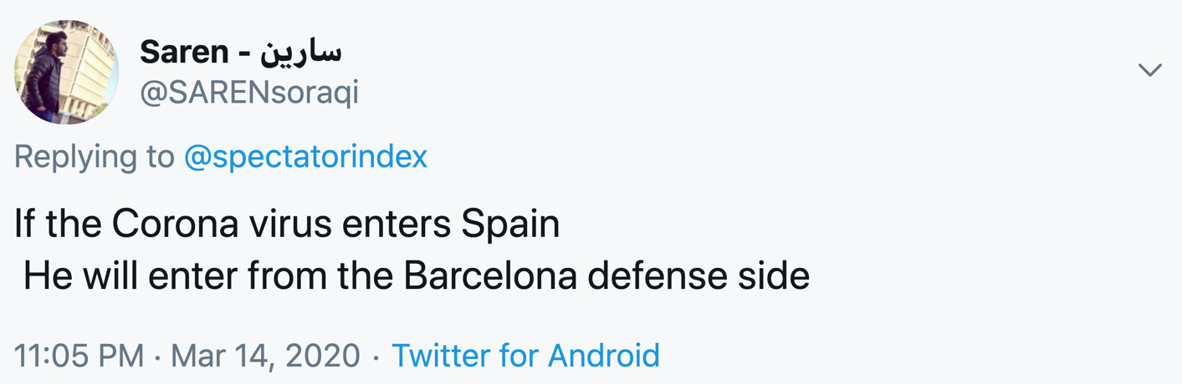
Jokes
11

Slide 12
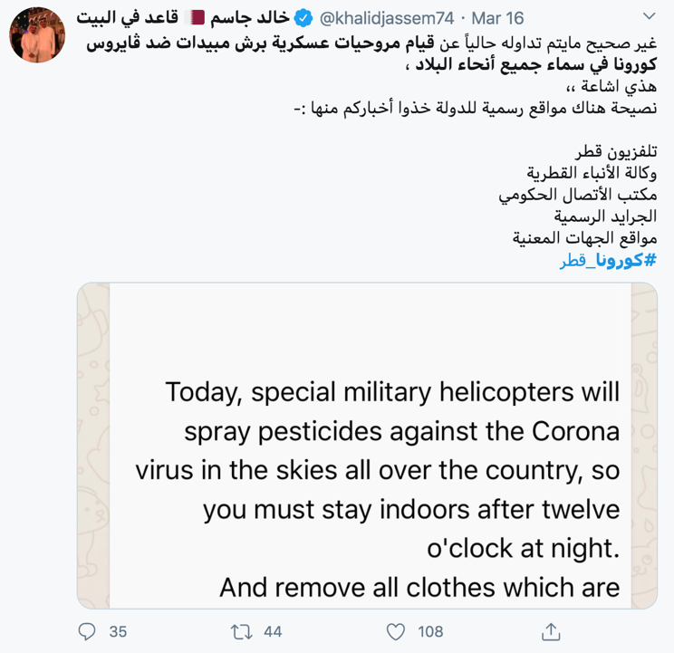
Rumors
12

Slide 13
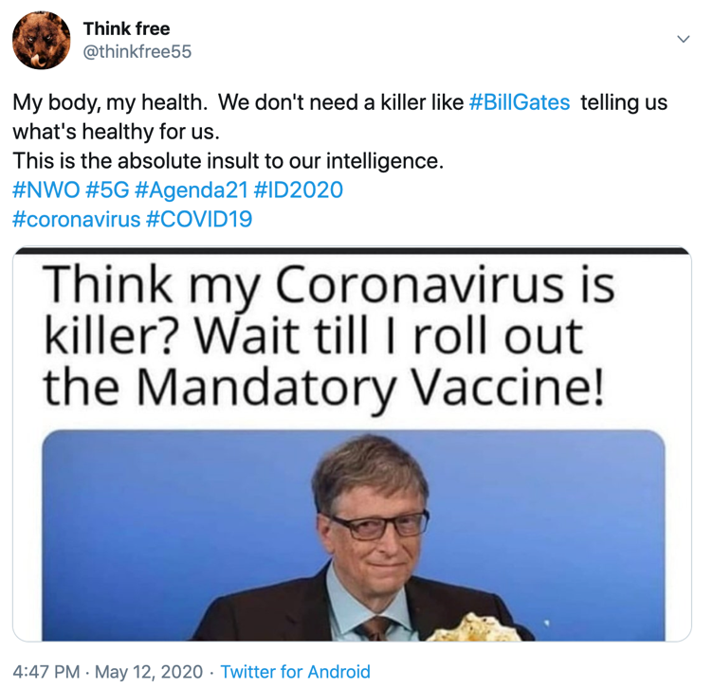
Conspiracies
13

Slide 14
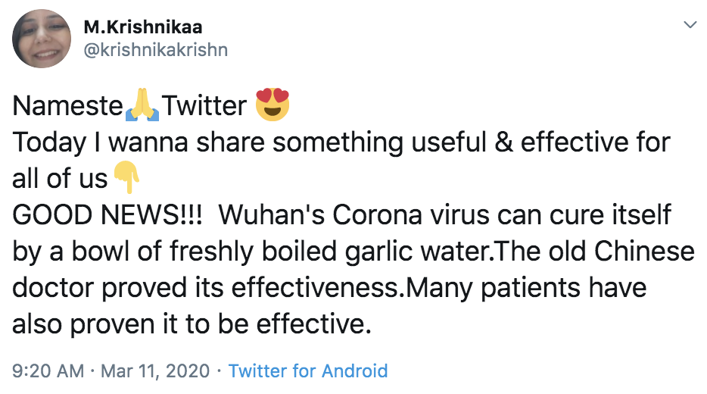
Fake Cure
14

Slide 15
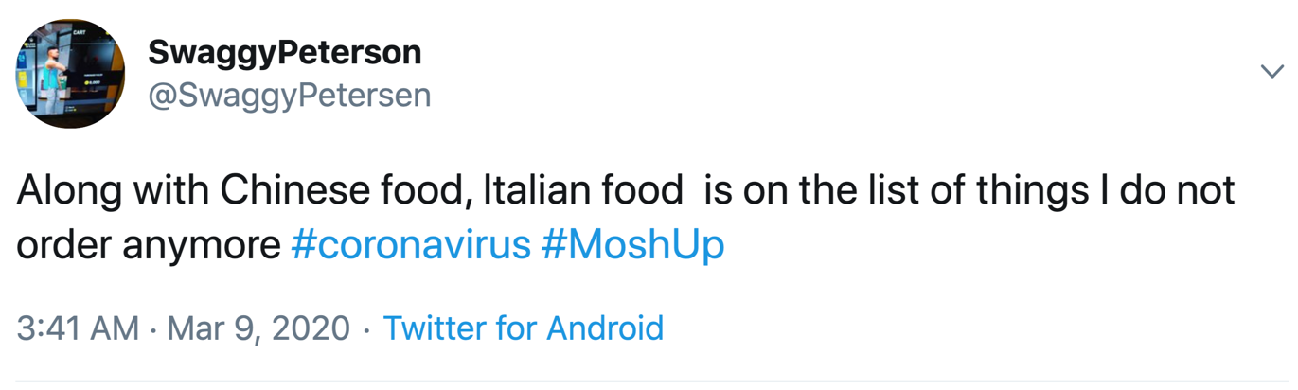
Xenophobia, Racism, Prejudices
15

Slide 16
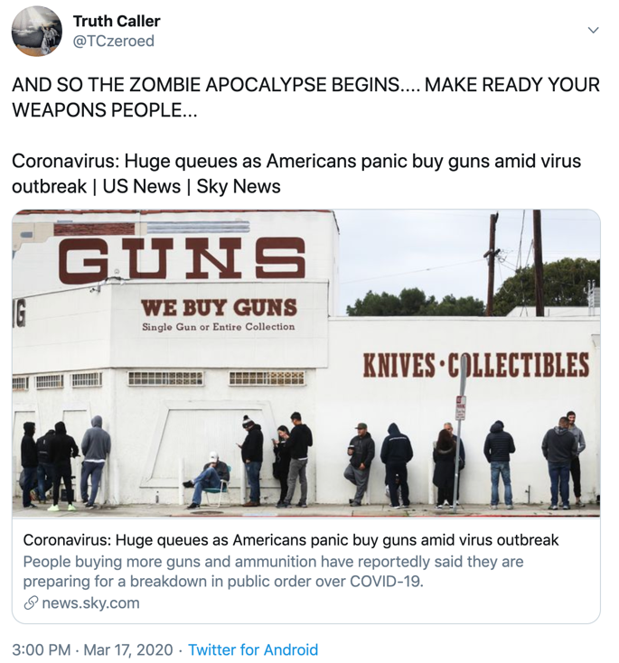
Spreading Panic
16

Slide 17
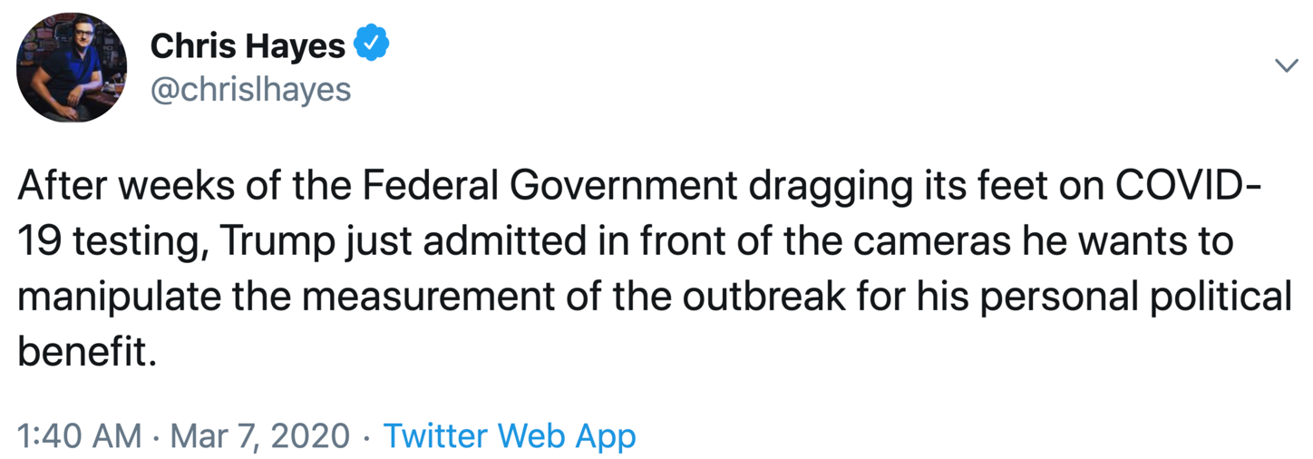
Blaming/Accusing the Authorities
17

Slide 18
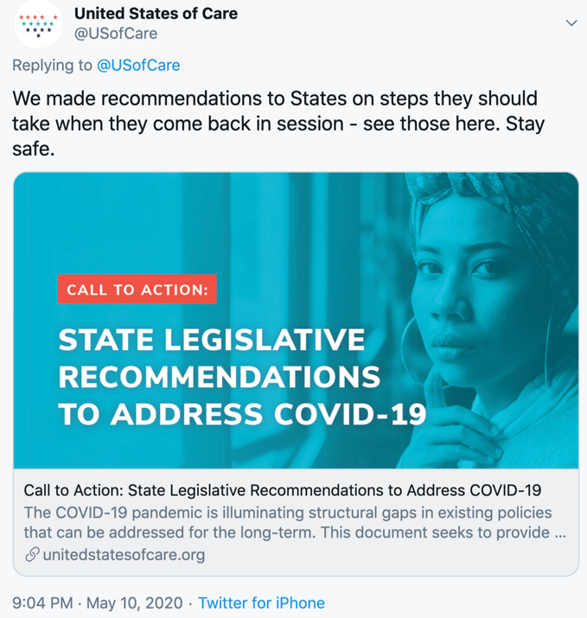
Advice/Recommendation
18

Slide 19
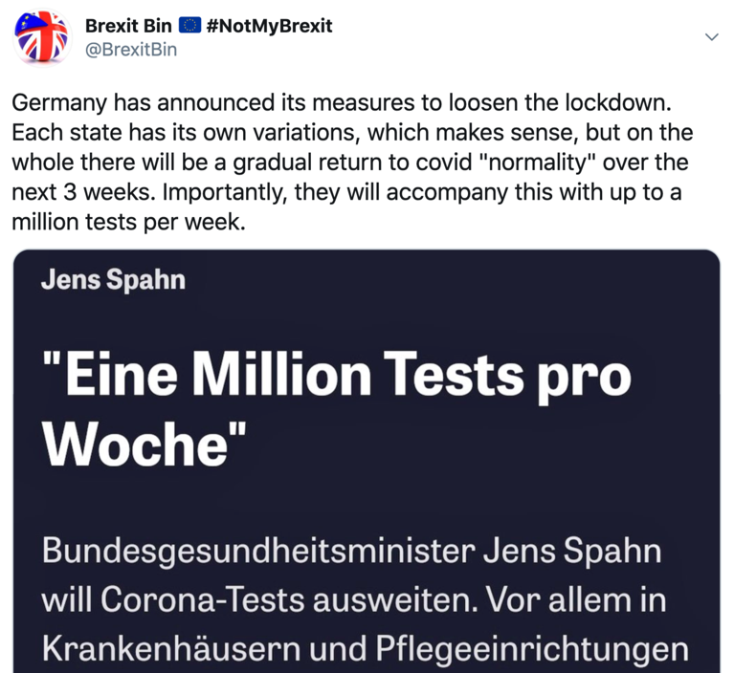
Discussing Action Taken
19

Slide 20
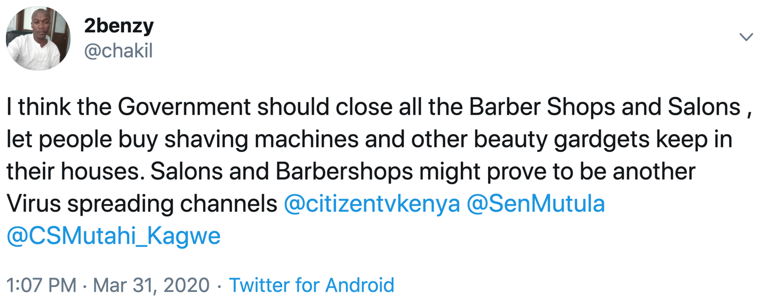
Call for Action
20

Slide 21
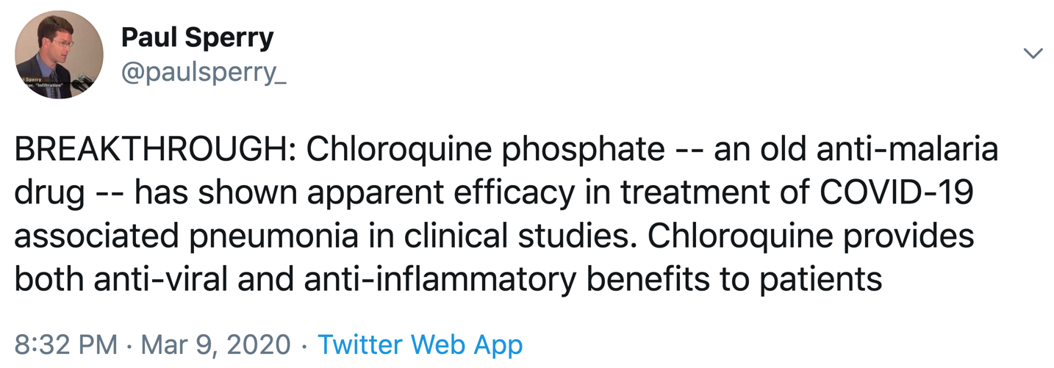
Discussing Possible Cure
21

Slide 22
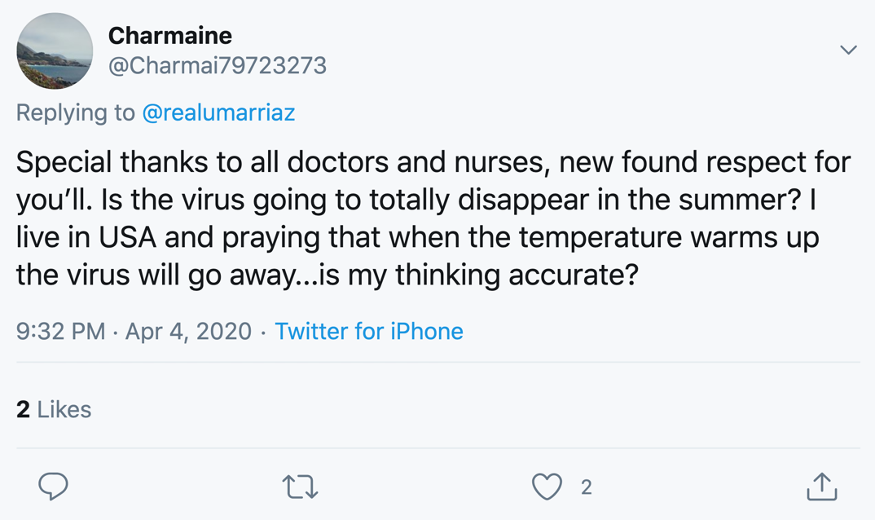
Asking a Question
22

Slide 23
Annotation Questions
Q1. verifiable factual claim?
Q2. false information?
Q3. of interest to the general public?
Q4: harmful to society, person, company or product(s)?
Q5. worth fact-checking?
Q6. harmful to society and why?
Q7. should get the attention of policy makers?
23

Slide 24
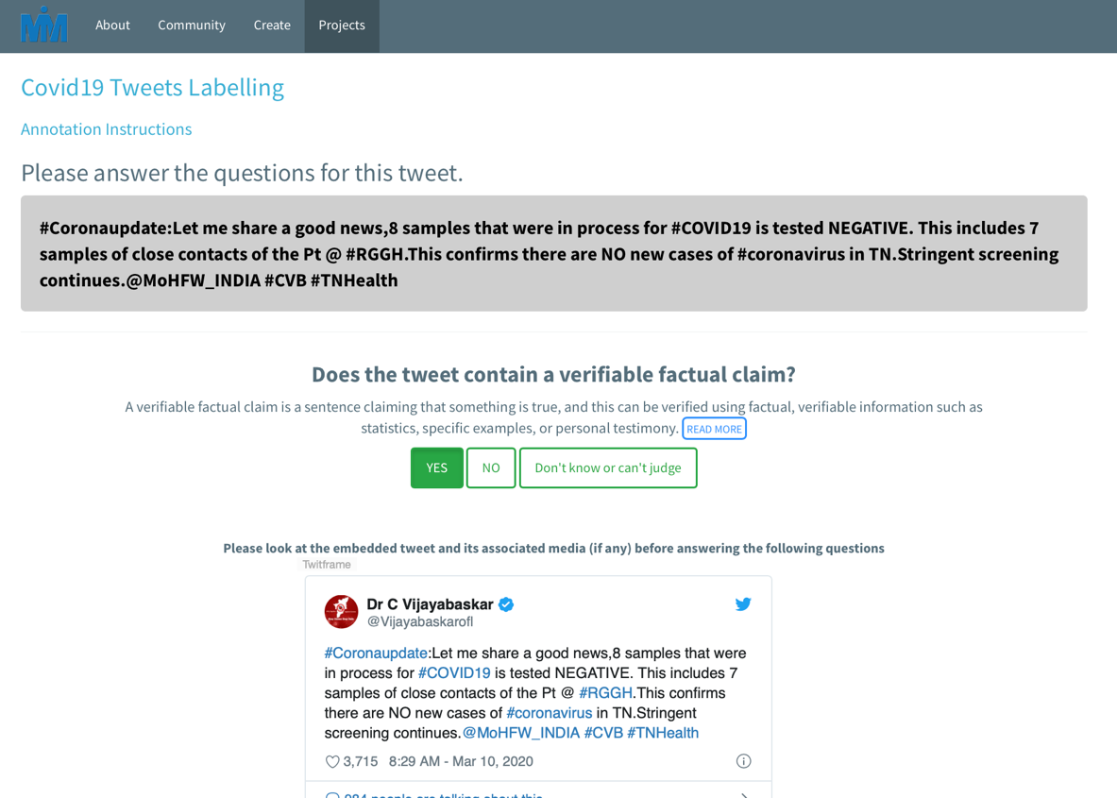
24

Slide 25
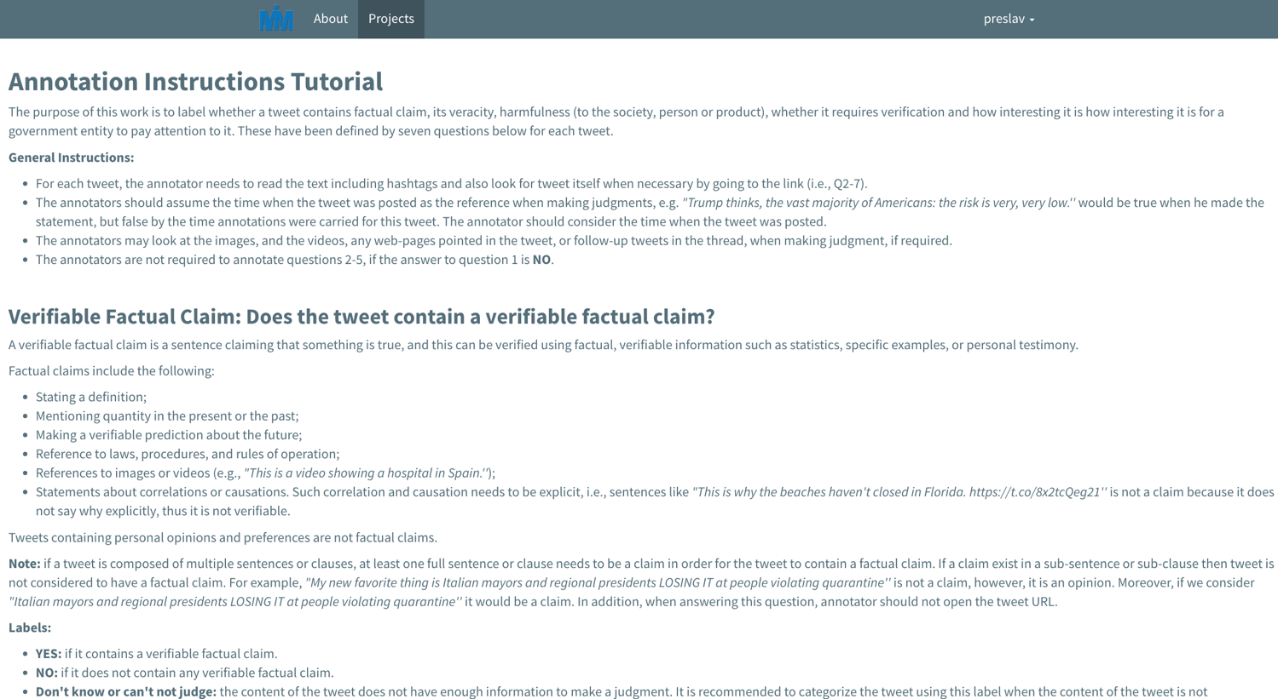
https://micromappers.qcri.org/project/covid19-tweet-labelling/tutorial
25

Slide 26
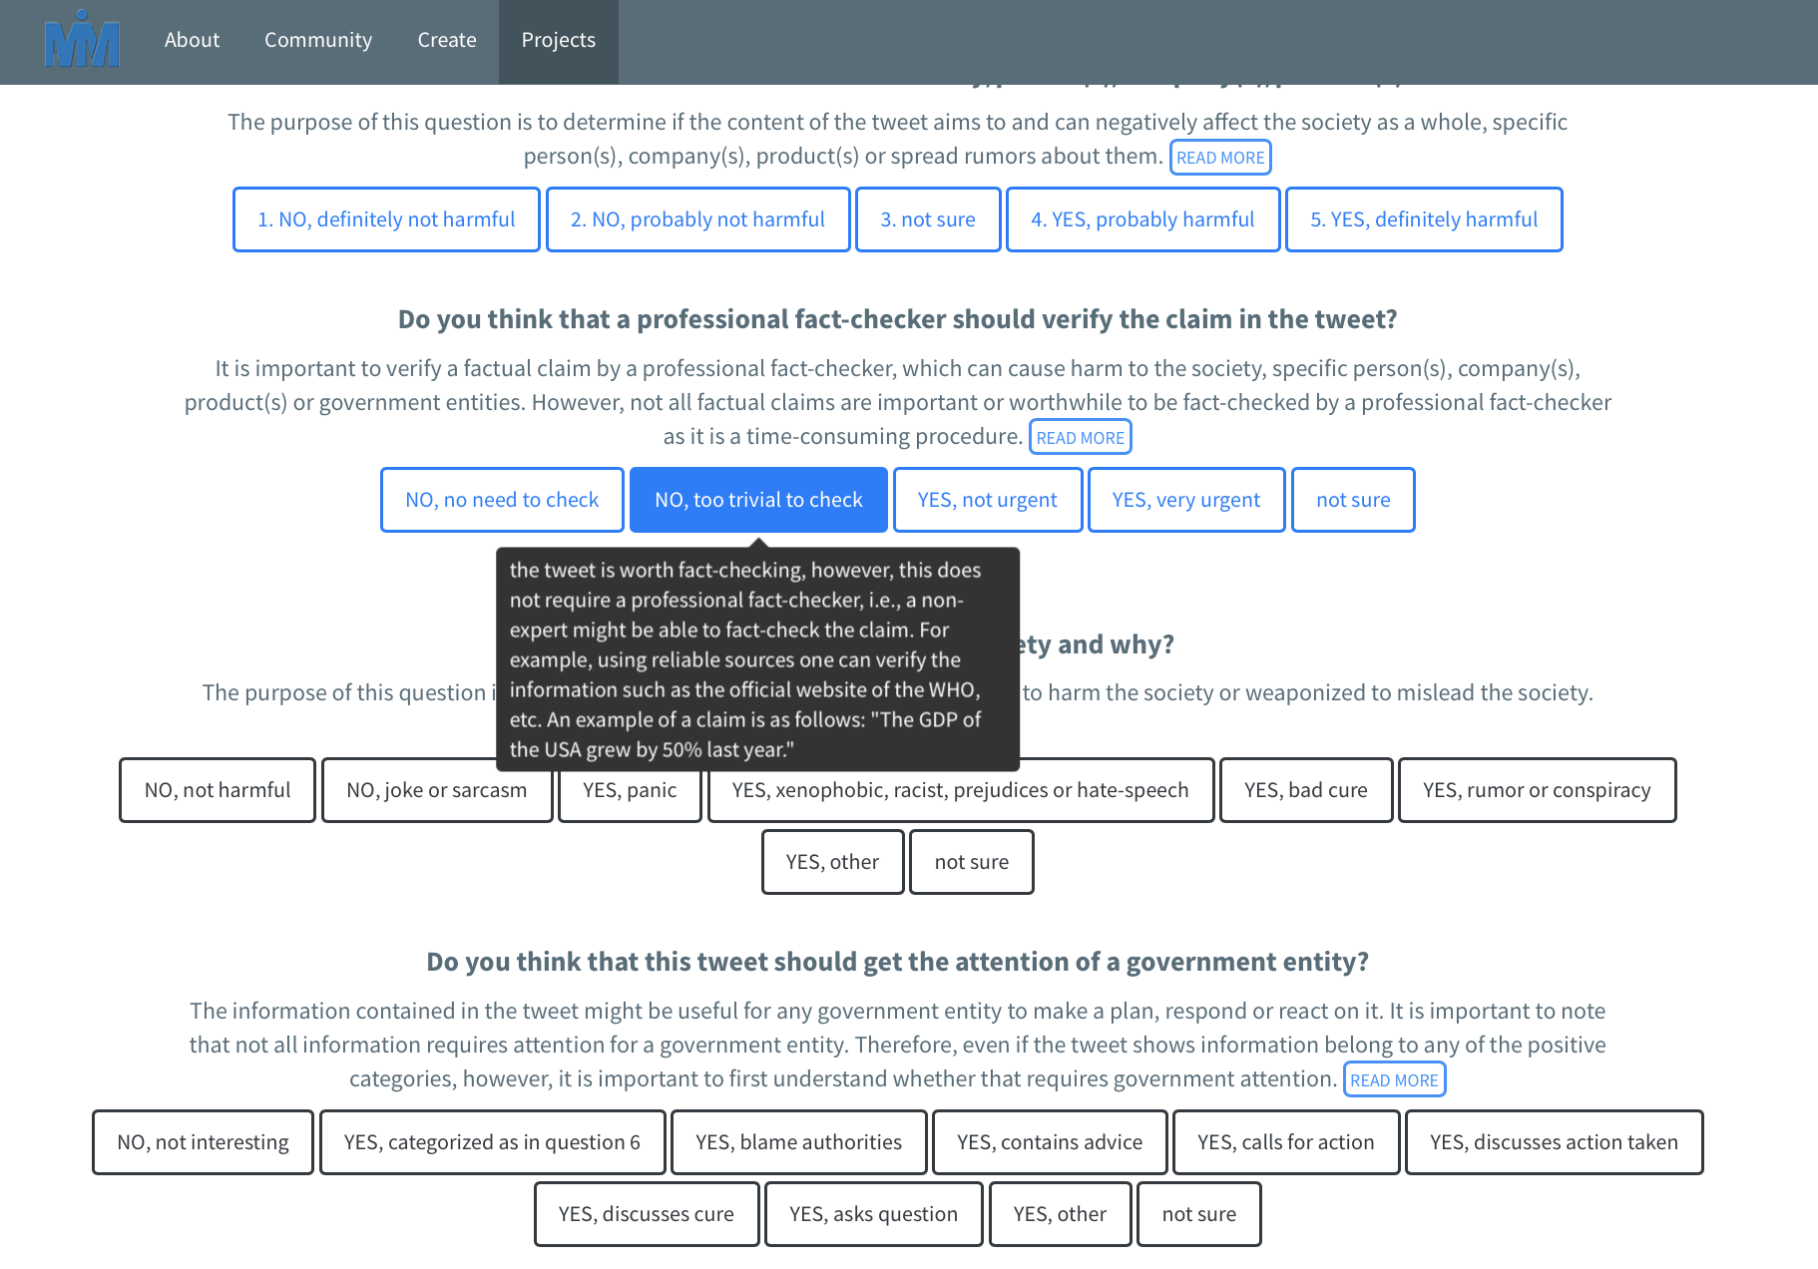
26

Slide 27
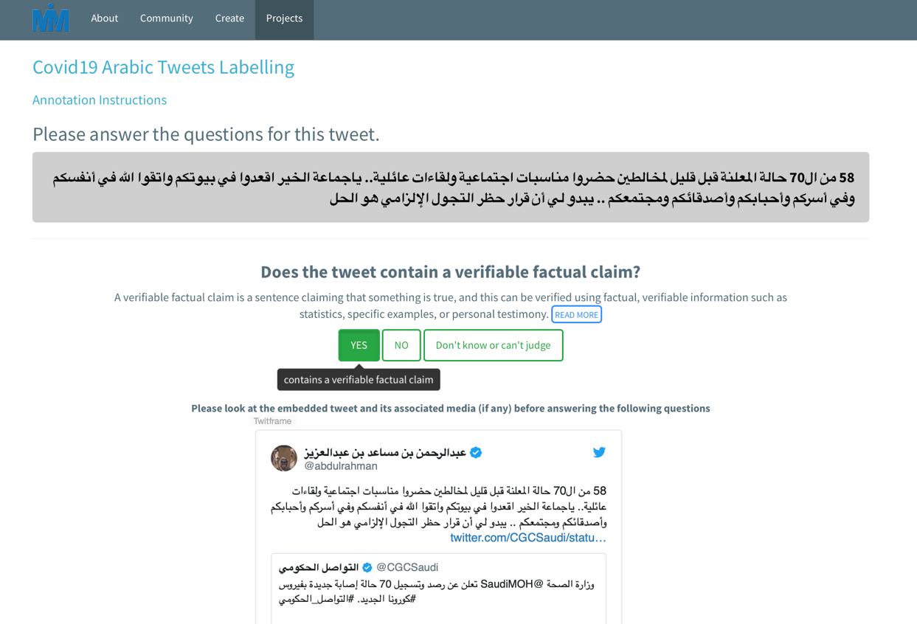
27

Slide 28
English Tweets (by Source)
28

Slide 29
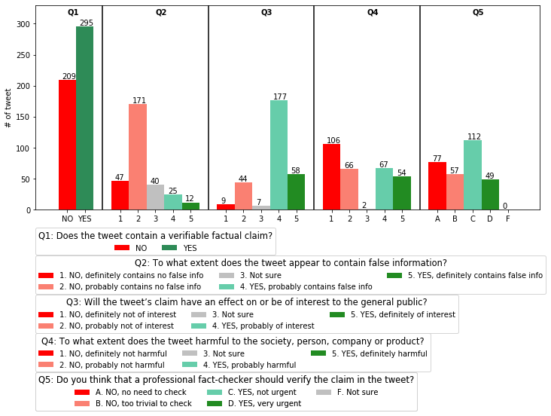
29

Slide 30
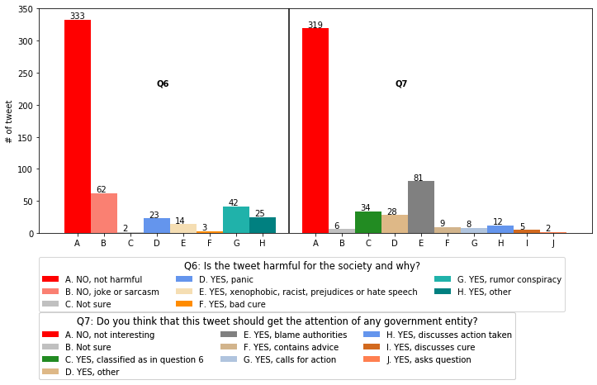
30

Slide 31
Arabic Tweets (by Source)
31

Slide 32
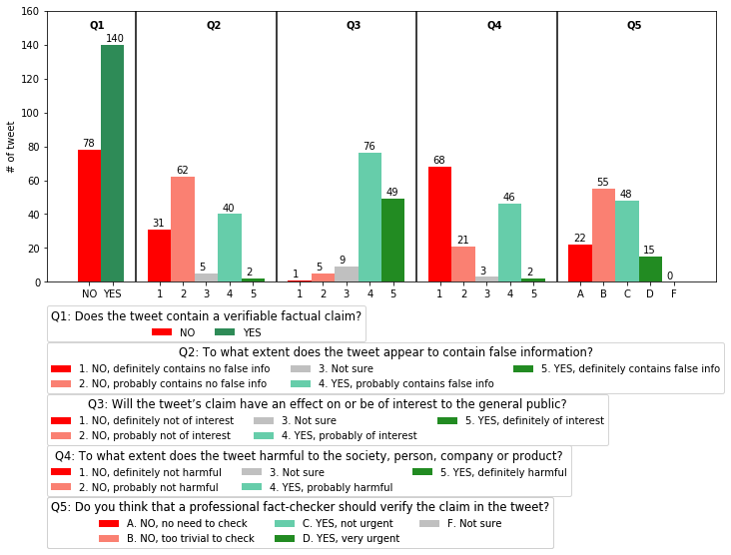
32

Slide 33
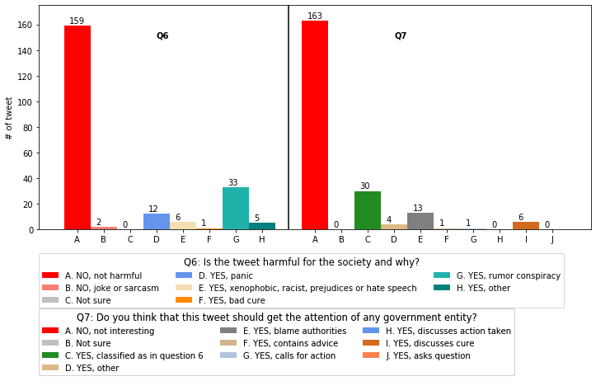
33

Slide 34
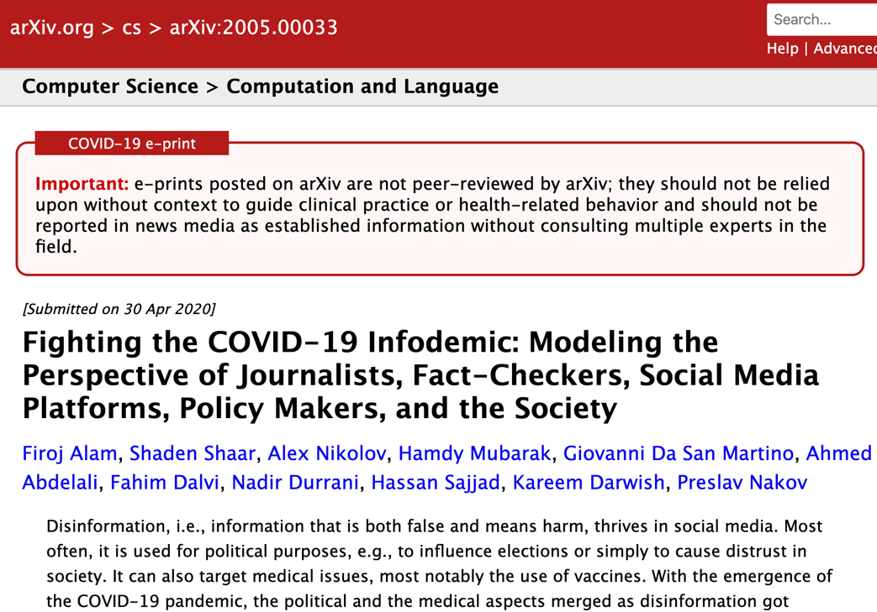
34

Slide 35
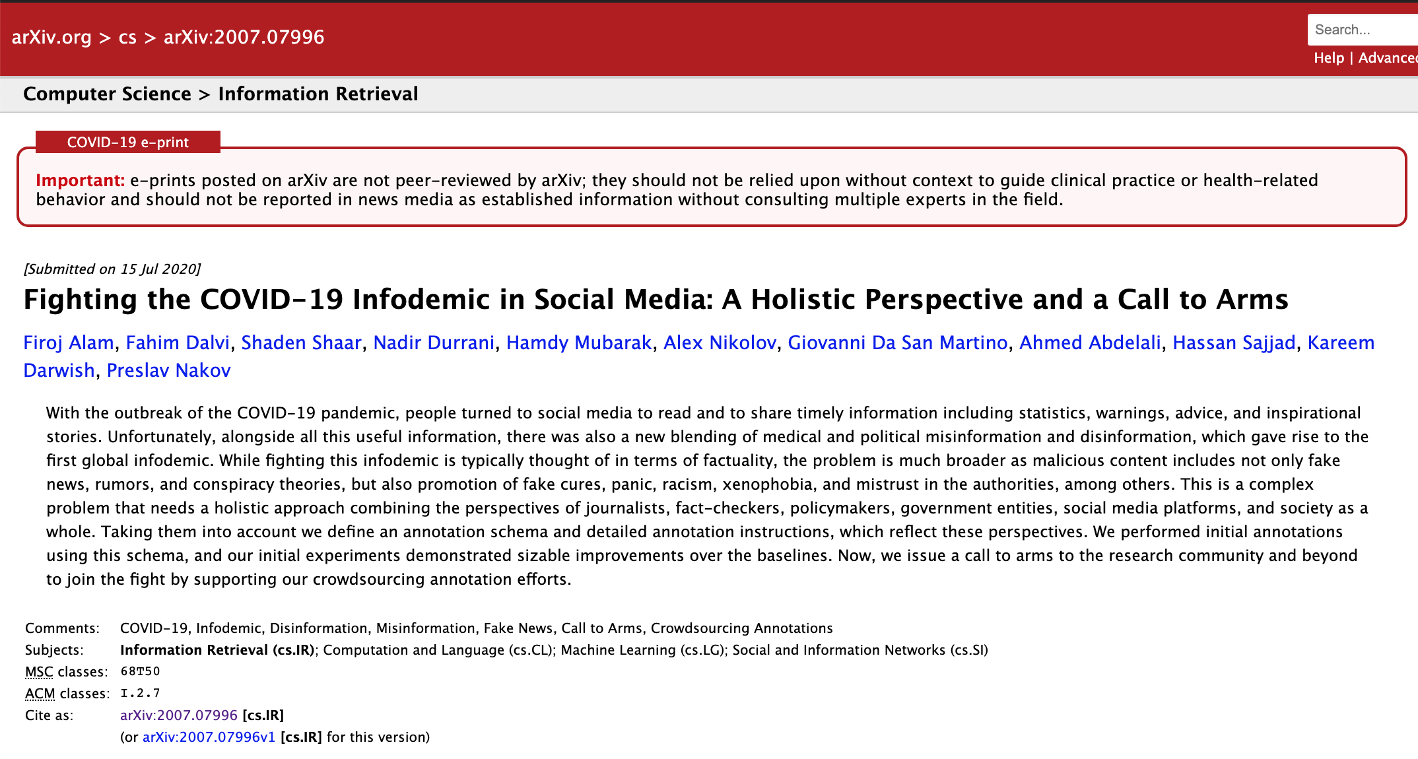
35
35

Slide 36

Call to Arms: Let Us Annotate More!
  English: https://micromappers.qcri.org/project/covid19-tweet-labelling/
  Arabic: https://micromappers.qcri.org/project/covid19-arabic-tweet-labelling/
36

Slide 37
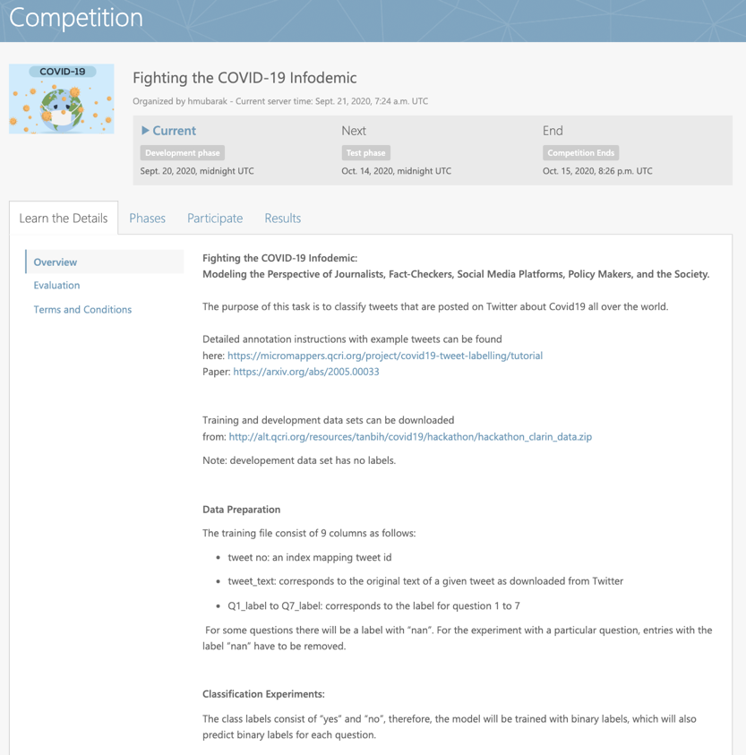
37
https://competitions.codalab.org/competitions/26428

Slide 38
Yes, it can be done!

Slide 39
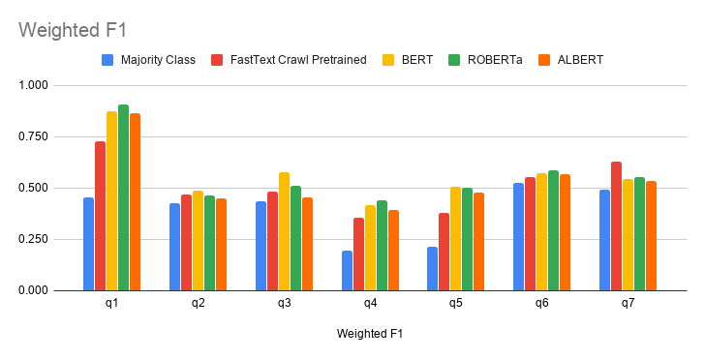
39

Slide 40
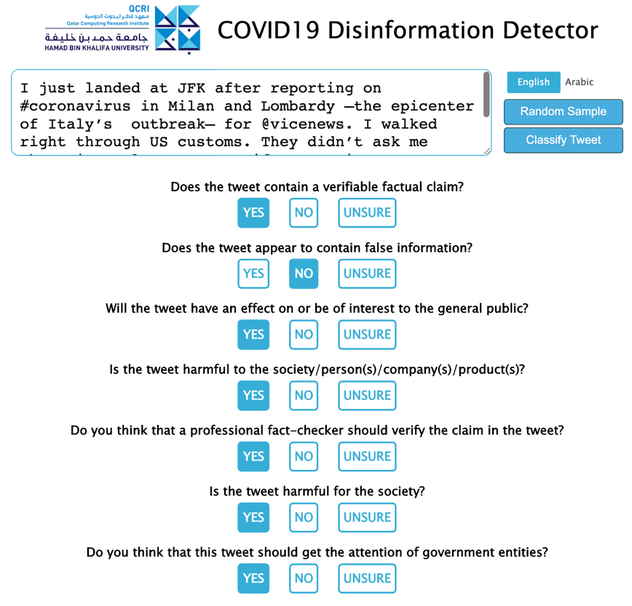
40

Slide 41
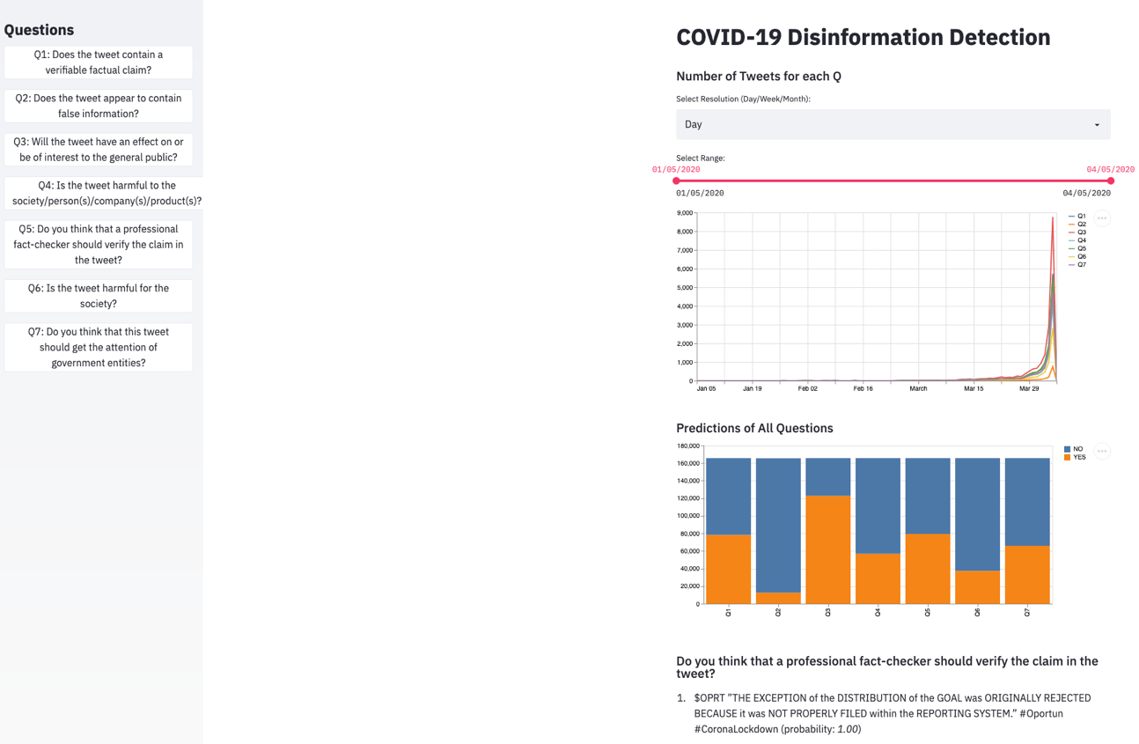
41

