Slide 1
Vocabularies for CMDI
CLARIN CMDI Taskforce
& friends
The CMDI Sessions
Session #2
14 December 2021
Zoom

Slide 2
Agenda
Vocabularies for CMDI
What is the current vocabulary support in CMDI (Menzo Windhouwer)
The User’s perspective (Jan Odijk)
The Modeler’s perspective (Penny Labropoulou)
Vocabulary pitches
Hanna Hedeland
Oddrun Ohren
Discussion

Slide 3
CMDI core workflow
CMDI profile
XML Schema⁺⁺
CMDI record
derive
validate

Slide 4
Vocabularies
Lists of
Terms, e.g., genres
Entities, e.g., languages, organisations
Modes to use
Closed
The given list of values is complete, e.g., main research field
One or more of the given values have to be selected
Open
The given list of values is partial, e.g., organisations
The given values are preferred, suggestions, examples
Not in scope today!
LD vocabularies: how RDF classes & properties relate
Semantics are for CMDI in the realm of ConceptLinks & CCR
Vocabulary items can have ConceptLinks to make their semantics explicit

Slide 5
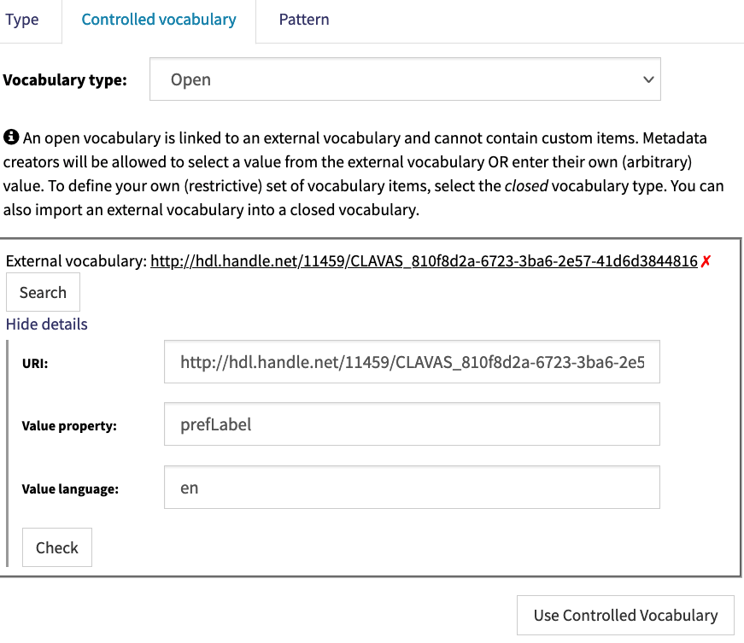
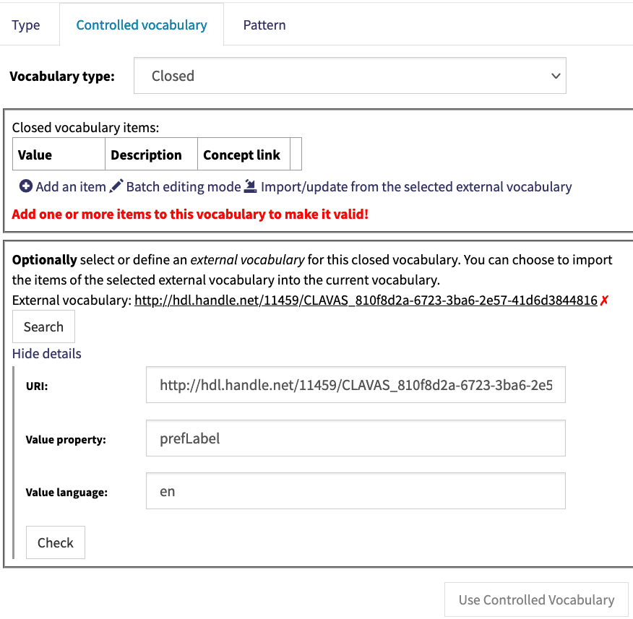
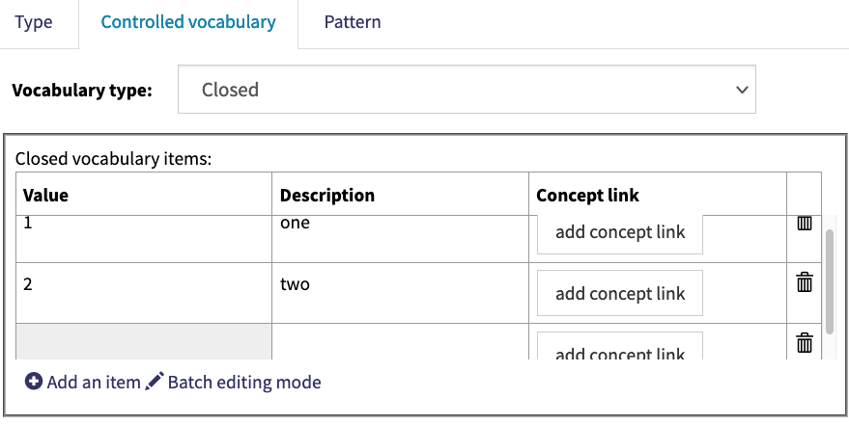
Vocabulary support in CMDI
Pre CMDI 1.2
Embedded closed vocabularies, e.g., iso-country
Included in the XML schema, i.e., validated!
CMDI 1.2
Link to CLAVAS vocabulary
Closed: embedded + CLAVAS link, e.g., iso-639-3
(selection of) CLAVAS vocabulary is copied to embedded closed vocabulary
Open: CLAVAS link only
Link instance to vocabulary item via ConceptLink
<cmdp:org cmd:ValueConceptLink=“http://.../clavas/...”>Meta</cmdp:org>

Slide 6
CLAVAS
https://vocabularies.clarin.eu/clavas/
A vocabulary service originally developed in CLARIN-NL
Provides an API to (incrementaly) search for vocabulary items, to be used by, e.g., an editor
Contains just one vocabulary
ISO 639-3 language codes + labels
not the latest, but in sync with components/profiles in use
On the shelf
Licenses
MIME types
Organisations (needs sync)
Why so little?
Prevent proliferation: one vocab per domain
Who claims ownership to deal with change request?
How to deal with versioning/subsets?

Slide 7
Agenda
Vocabularies for CMDI
What is the current vocabulary support in CMDI (Menzo Windhouwer)
The User’s perspective (Jan Odijk)
The Modeler’s perspective (Penny Labropoulou)
Vocabulary pitches
Hanna Hedeland
Oddrun Ohren
Discussion

