Slide 1

What's on the agenda?
Topic modelling parliamentary debates before and during the COVID-19 pandemic
CLARIN2022 / Teaching with CLARIN / 11 October 2022

Slide 2
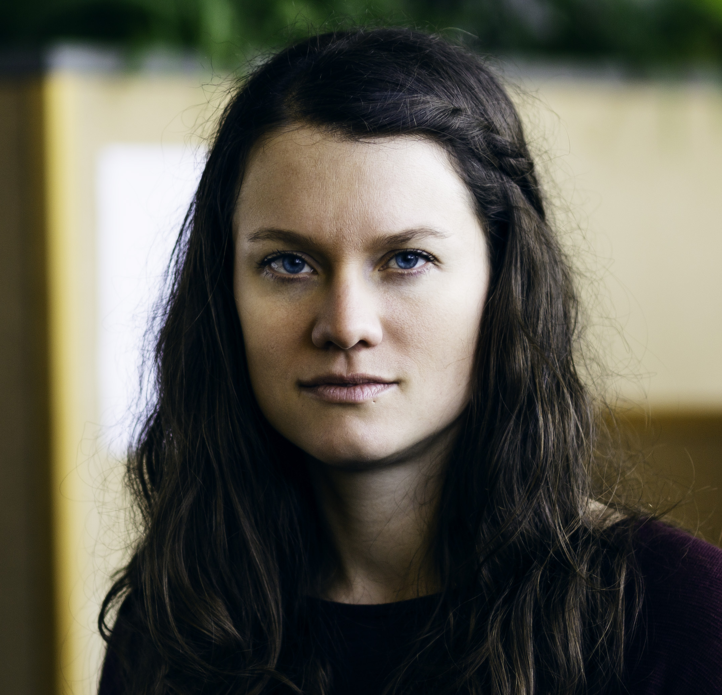
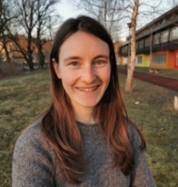
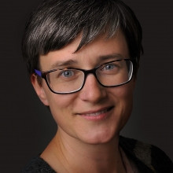
authors
Ajda Pretnar Žagar
Kristina Pahor de Maiti
Darja Fišer

Slide 3
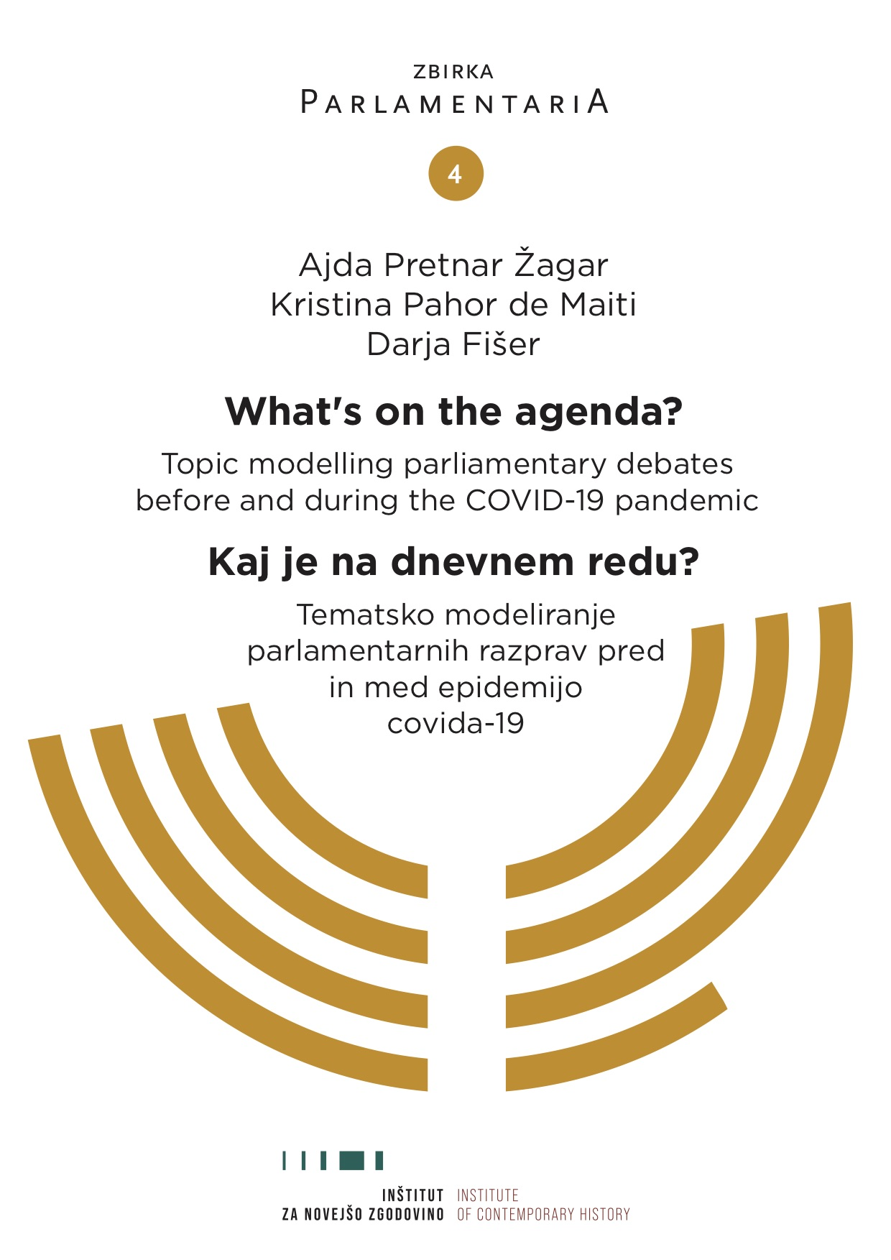
motivation
Need for more resources for complete beginners in digital humanities.
Topic modelling popular.
Raising awareness of the method.
ParlaMint corpora.

Slide 4
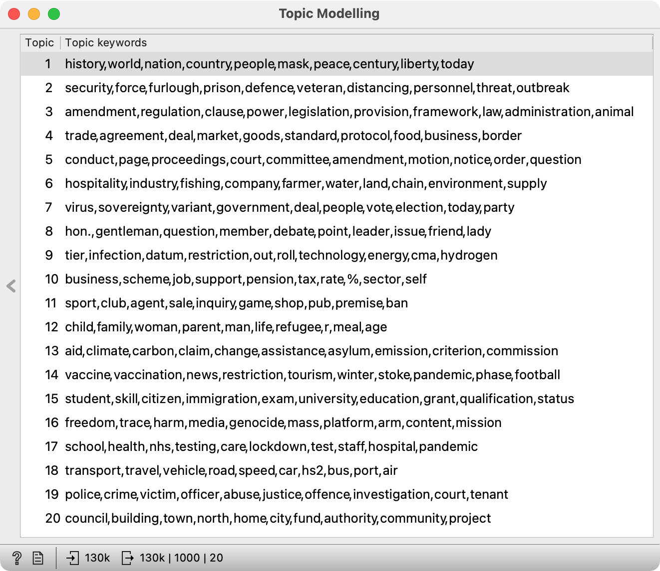
training resource
Topic: topic modelling
Aim: present LDA on parliamentary data
Target audience: beginners in DH
Expected workload: self-study, ~3 hours
Relevance: three practical tasks

Slide 5
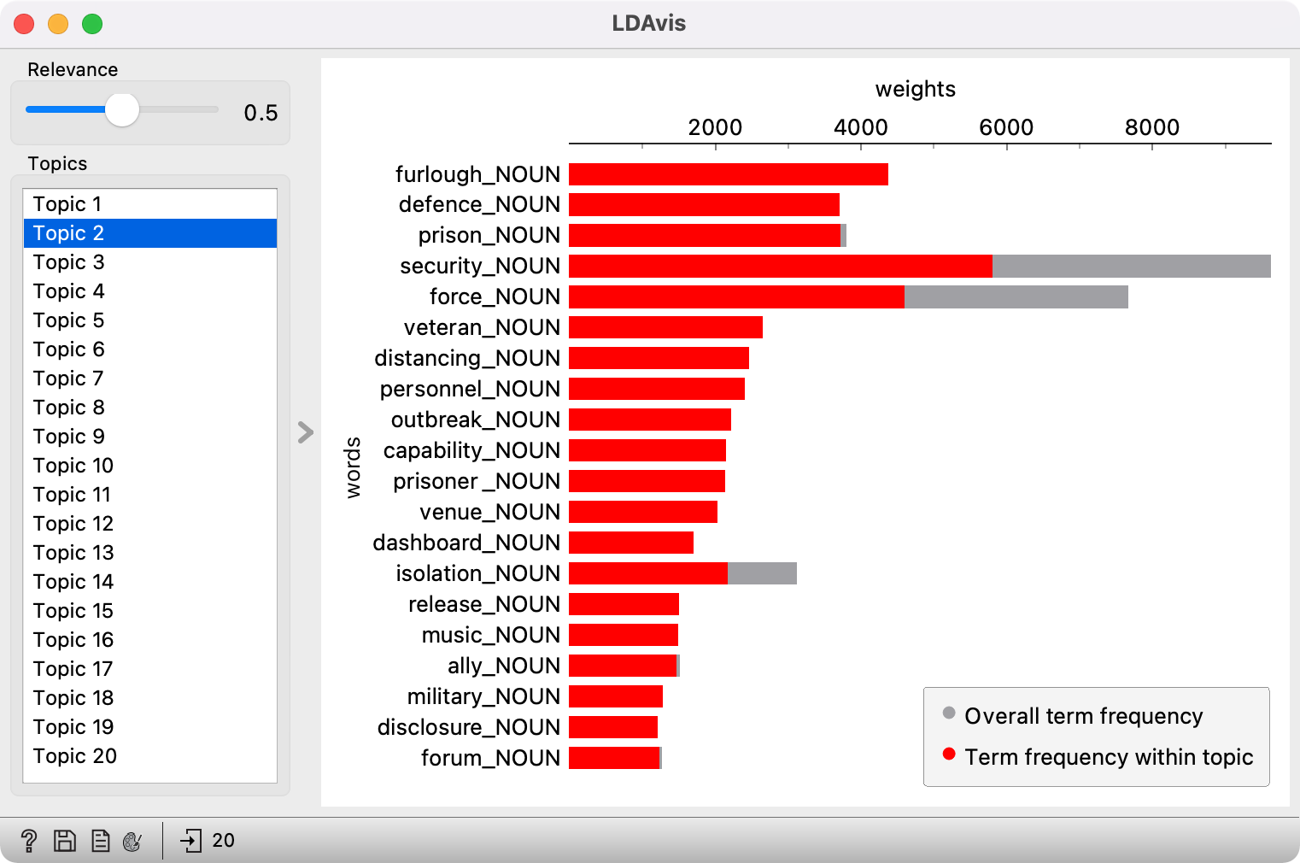
challenges
Extremely large corpora
Support for .conllu
Length vs. details
Novel visualizations

Slide 6
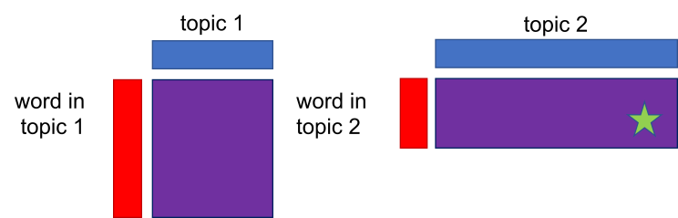
adaptability
Resource can be used:
as extended homework
with other corpora (parliamentary or otherwise)
one task as an example
easy explanation of LDA

Slide 7

contact
ajda.pretnar@inz.si
https://github.com/ajdapretnar

