Slide 1
Beyond Babylonian Confusion a case-study based approach for multilingual NLP on historical literature
Tess Dejaeghere
Julie M. Birkholz, Els Lefever, Christophe Verbruggen
This project has received funding from the European Union’s Horizon 2020 research and innovation programme under grant agreement No 101004984
Notes:
Hi everyone, I would like to introduce my work regarding multilingual NLP on historical literature.

Slide 2
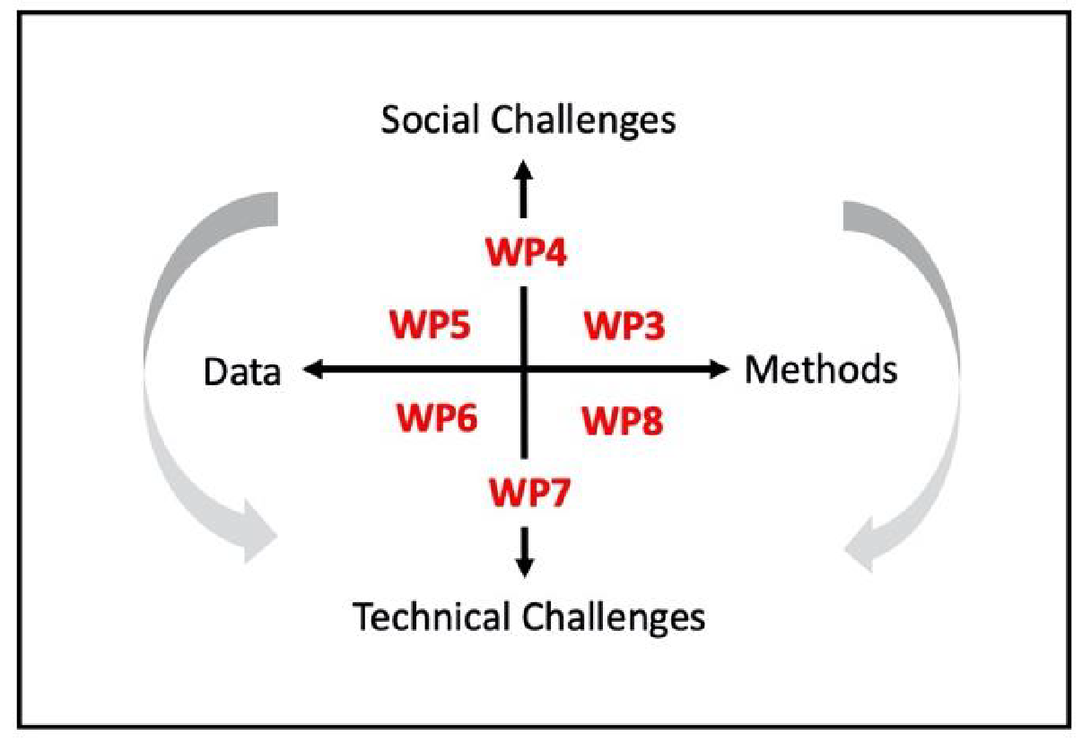
Background
Deliverables
Machine learning pipeline for the extraction of Named Entities.
Prototype to extract relations between entities.
A lexicon-based and Machine learning pipeline for sentiment analysis.
Computational Literary Studies Infrastructure (CLS INFRA) is a four-year partnership to build a shared resource of high-quality data, tools and knowledge to aid new approaches to studying literature in the digital age.
Notes:
My project is funded by the Computational Literary Studies Infrastructure project. This is a consortium of universities across Europe who want to build sound computational research infrastructures to study literature. That does not necessarily mean that we only build tools, but we are also concerned with which materials humanists need to support their work, and how we can link together the open-source materials that already exist?
Some universities are working on datasets, others are working on user needs, and we at the Ghent Center for Digital Humanities are focusing on methods; more specifically on the integration of NLP-methods such as NER, SA and REX to support digital literary analysis.

Slide 3
PhD-project
NLP-tools have a great potential to support literary-historical research, but this has been largely overlooked.
Available tools are not adjusted to literary-historical settings.
Little technical knowledge of historians and literary scholars.
Multiple languages in the same text.
We want to research how named entity recognition and sentiment analysis can support literary-historical research, and how we can convert these findings into durable NLP-workflows.
The workflows will be developed through a set of case studies conducted on a multilingual literary-historical corpus of travelogues.
Notes:
NLP-tools such as NER and SA are often overlooked in humanist research. For one, because these tools are not fit for historical texts, and also because humanist scholars often do not have enough knowledge of NLP to choose and adapt tools for their purpose. As a consequence, they often decide to revert to a method they are more acquainted with.
This is a perfectly valid decision, but as a consequence we have little insight on the application range of these tools.
So, long story short: we want to close this gap by exploring the ways in which NER and SA can support literary-historical research, and turn the output into durable and re-usable workflows.

Slide 4
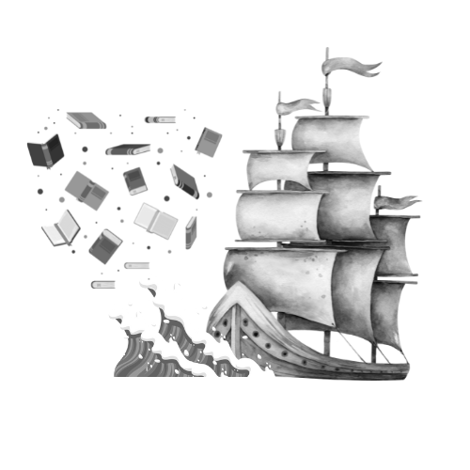
Travel literature as data
Compelling content
The exceptional characteristic of travelogues as highly idiosyncratic lenses into the past accounts for a wide range of linguistic and historical variance. Travelogues are a rendition of an author’s personal travel experiences, thus allowing the researcher to reconstruct writer identities, historic environments and cultural traditions.
Different genres
Journals, poetry, nature writing, travel memoirs, …
Multilingual
DEU, NL, FR, EN
Linguistic and historical variance
16th – 20th century
OCR mistakes
“Foreigners ma}^ without being naturalised, own property and exercise all rights, except political. The constitution assures to the Brazilian and the foreigner who resides in Brazil the inviolability of freedom and the safety of person and projjerty.”
Notes:
These workflows will be developed based on a couple of case studies inferred from a corpus of historical travel literature.
Content-wise, these texts can serve as lenses into the past, allowing us to build case studies related to the reconstruction of writer identities, historic environments and biodiversity, and cultural traditions. Our corpus contains a wide array of different genres, ranging from journals to nature writing – and are written in four different languages: German, Dutch, French and English. The texts range from the 16th to the 20th Century, and thus account for a lot of linguistic and historical variance, as well as the computational horror which is OCR mistakes.

Slide 5
Annotations
Visions on surroundings
Flora
Organisations
People
Locations
Fauna
Environment
A wide array of case studies
What is the attitude of the traveler regarding the people and tribes he/she meets?
Which animals were the travelers encountering?
What are the emotional values connected to elements of the environment?
…
Aspect-based Sentiment
Notes:
We want to annotate a GS sample of this corpus with two layers: one is a NER-layer which includes mentions of flora, fauna, locations, people (including the names of tribes and ethnic groups), organisations and environmental entities: think about weather phenomena, land cover and types of biomes.
On top of that, we want to add a ABSA-layer which will be connected to these entities.
In theory, this would allow us to work out a wide array case studies on e.g. the attitude of travelers regarding elements of the historical environment and biodiversity, and grant us more insight in the application range of NER and SA for literary analysis.

Slide 6
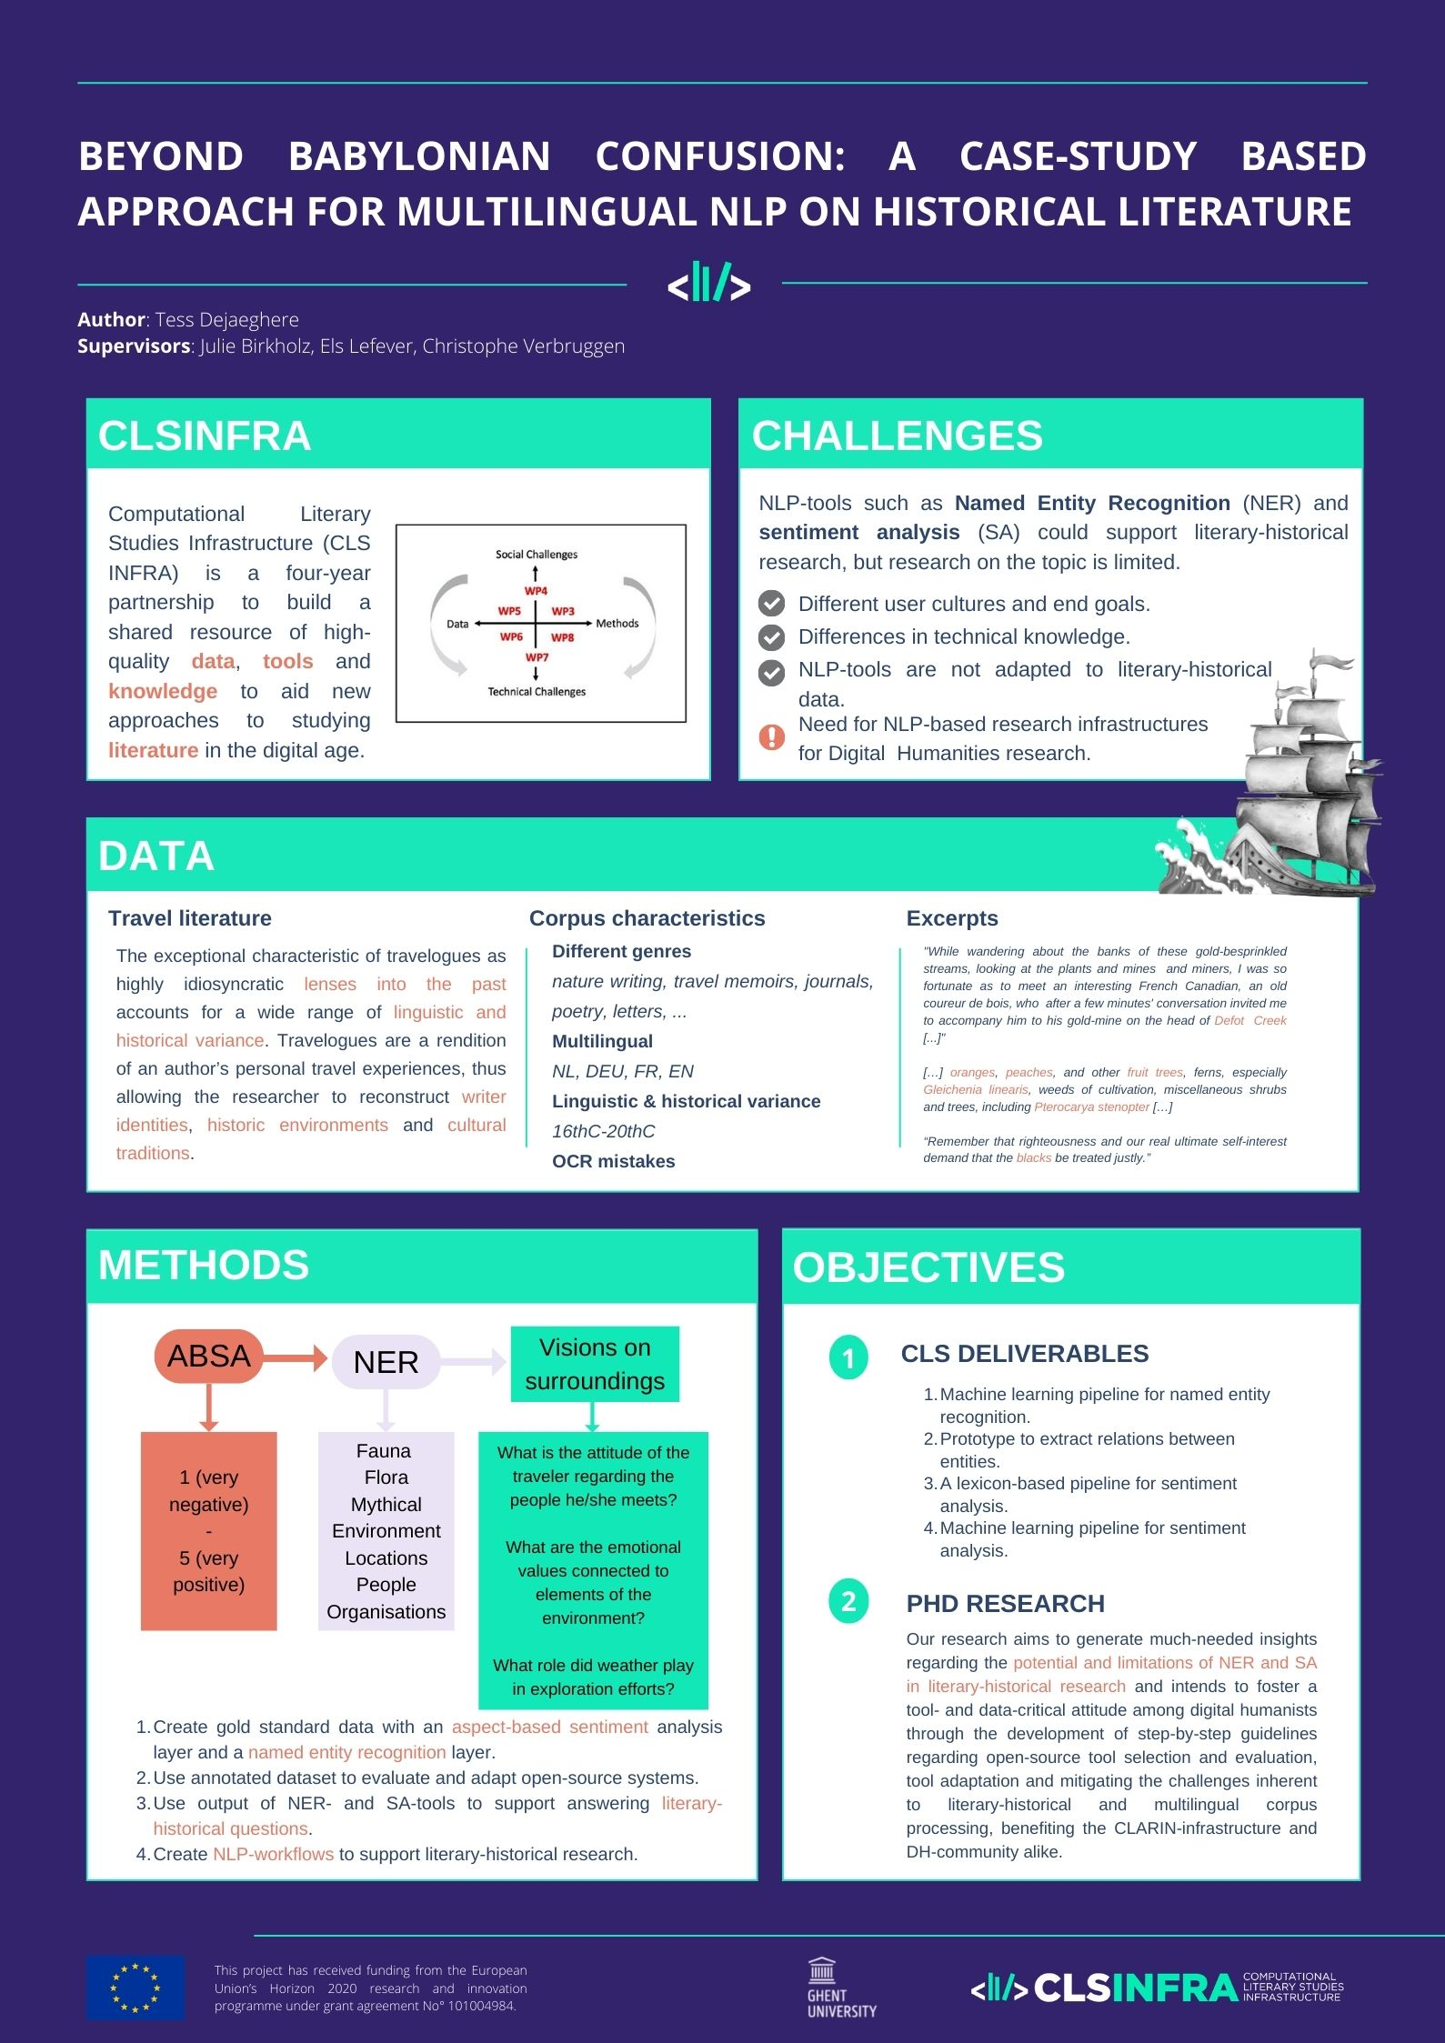
THANK YOU
Tess.Dejaeghere@ugent.be
@CLSinfra
@GhentCDH
@DejaeghereTess
Notes:
Thank you for your attention, this was of course a very brief overview so please find me @the poster session for further discussion

