Slide 1
Using classical readability formulas to measure text readability in Sesotho
Sibeko Johannes

Slide 2
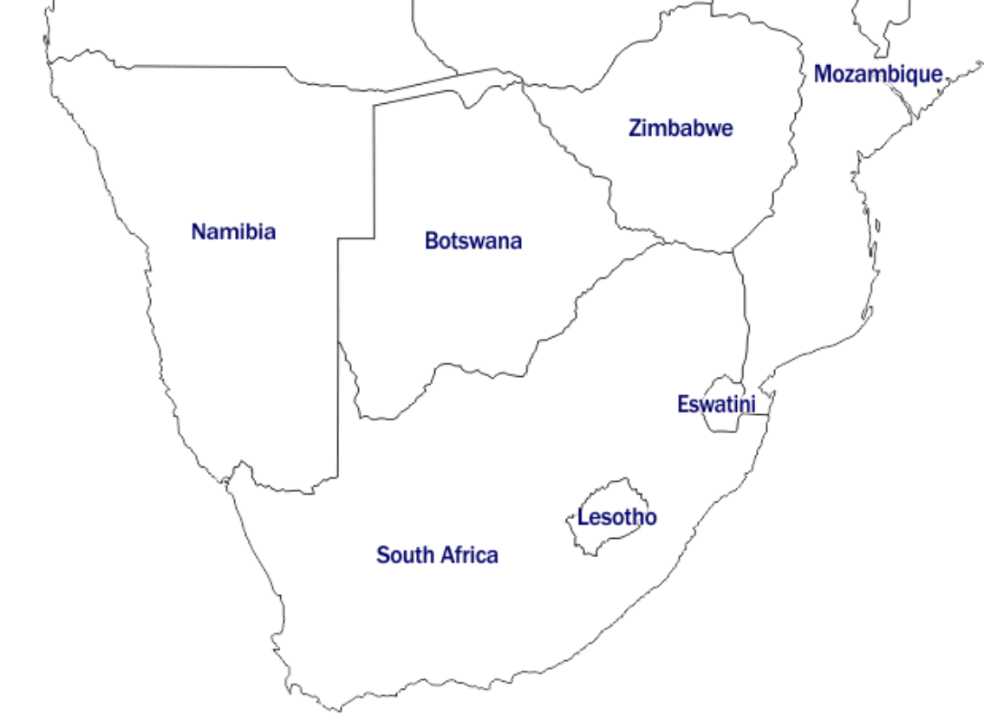
Recognized language
Official language
Where is Sesotho spoken

Slide 3
QUICK BACKGROUND
How could text readability be measured in Sesotho?
How could this be automated?
Translated texts
  English as helper language?
  Dutch as helper language?
Classical readability metrics

Slide 4
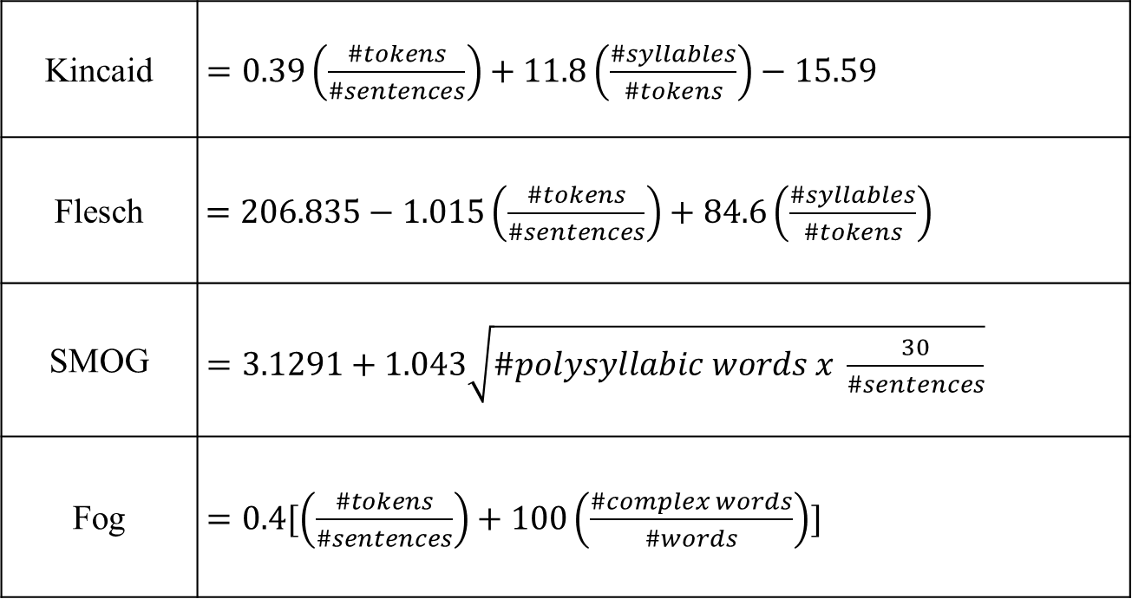
CLASSIC READABILITY FORMULAS
Kincaid | $=0.39\left(\frac{\#tokens}{\#sentences}\right)+11.8\left(\frac{\#syllables}{\#tokens}\right)−15.59$
Flesch | $=206.835−1.015\left(\frac{\#tokens}{\#sentences}\right)+84.6\left(\frac{\#syllables}{\#tokens}\right)$
SMOG | $=3.1291+1.043\sqrt{\#polysyllabic words x \frac{30}{\#sentences}}$
Fog | $=0.4[\left(\frac{\#tokens}{\#sentences}\right)+100\left(\frac{\#complex words}{\#words}\right)]$
Syllable-based
Notes:
The Flesch-Kincaid Grade Level, the Flesch Reading Ease, the Simple measure of Goobledygook and the Gunning Fog index are based on syllable counts. The Flesch-Kincaid Grade Level and the Flesch Reading Ease are based on the overall syllable counts while the simple measure of Goobledygook are specific on the number of syllables considered. That is, they only consider words with three or more syllables.

Slide 5
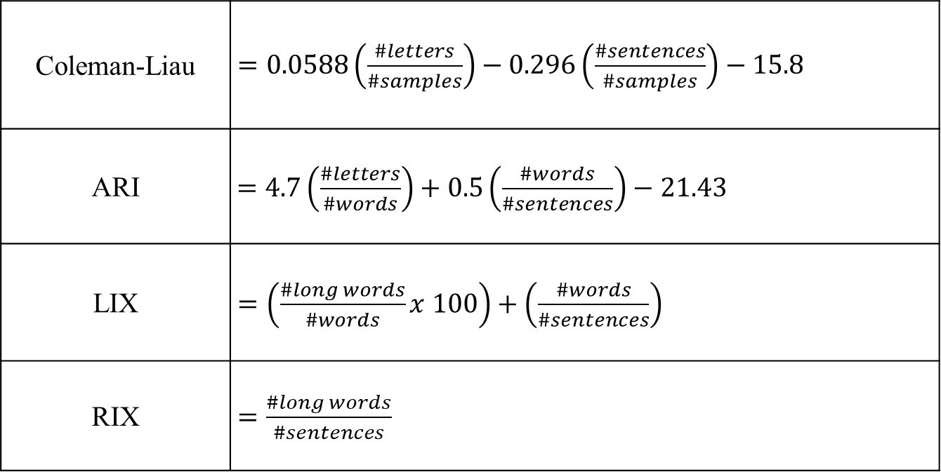
CLASSIC READABILITY FORMULAS
Coleman-Liau | $=0.0588\left(\frac{\#letters}{\#samples}\right)−0.296\left(\frac{\#sentences}{\#samples}\right)−15.8$
ARI | $=4.7\left(\frac{\#letters}{\#words}\right)+0.5\left(\frac{\#words}{\#sentences}\right)−21.43$
LIX | $=\left(\frac{\#long words}{\#words}x 100\right)+\left(\frac{\#words}{\#sentences}\right)$
RIX | $=\frac{\#long words}{\#sentences}$
Word-length based
Notes:
The coleman-liau index, the Automatic readability index, the Lasbarhets index and the Rate index are based on the number of characters in a text or sample as in the case of the Coleman-Liau index. Additionally, the Lasbarhets index and the Rate Index consider the percentage of long words that are composed of seven or more characters.

Slide 6
CLASSIC READABILITY THEORIES
Dale-Chall | $=0.0496\left(\frac{\#words}{\#sentences}\right)+11.8\left(\frac{\#difficult words}{\#words}\right)x 0.1579+3.6365$
Frequency-list based
Notes:
Finally, we considered the Dale-Chall index which is a different from the other metrics in that it uses a frequency list. The frequency list is based on a list of 3000 words that a grade 4 learner is expected to be familiar with. If the words in the analysed text is not present in this list of 3000 frequently used words, then the words is considered difficult.

Slide 7
CONNECTION TO CLARIN
Syllabification system
Syllabification corpus
Machine Translation corpus
Exam text domain corpus
End goal: Text readability system

Slide 8
Johannes Sibeko

