Slide 1


Linguistic autobiographies
Towards the creation of a multilingual resource family
Silvia Calamai (University of Siena, Italy, Rosalba Nodari (University of Siena, Italy), Claudia Soria (CNR-ILC, Italy), Alessandro Carlucci (University of Bergen, Norway)

Slide 2

What is a linguistic autobiography?
A narrative, non-fictional text where the author explicitly reflects on the relationship between him/herself and the language.
  Acquisition and interaction of different languages as acquisition of selfhood
  Strong emphasis on the linguistic component
10/10/22
CLARIN Annual Conference, Prague
Notes:
di solito raccolto in modo scritto

Slide 3
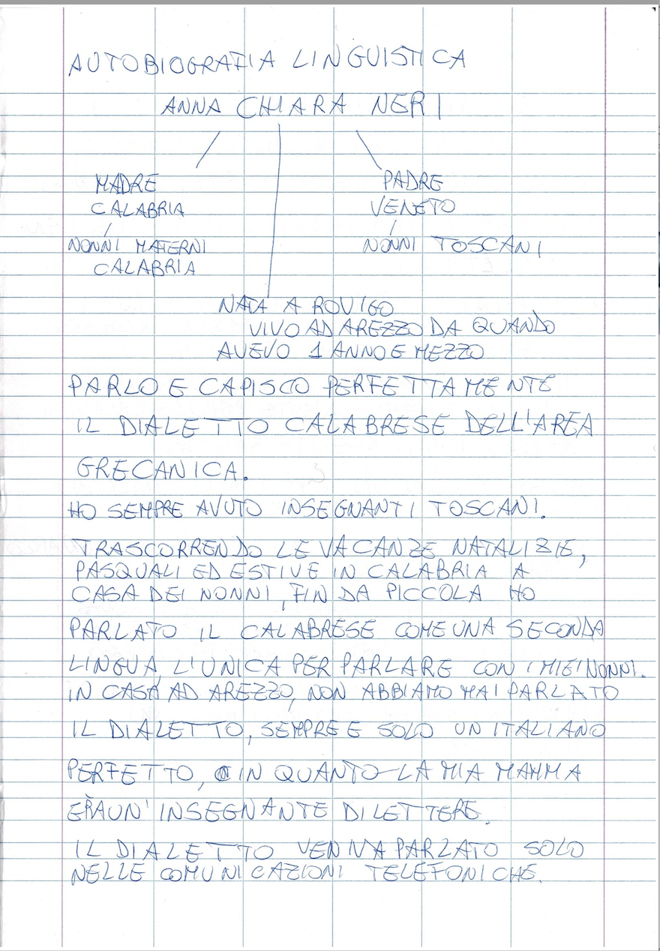
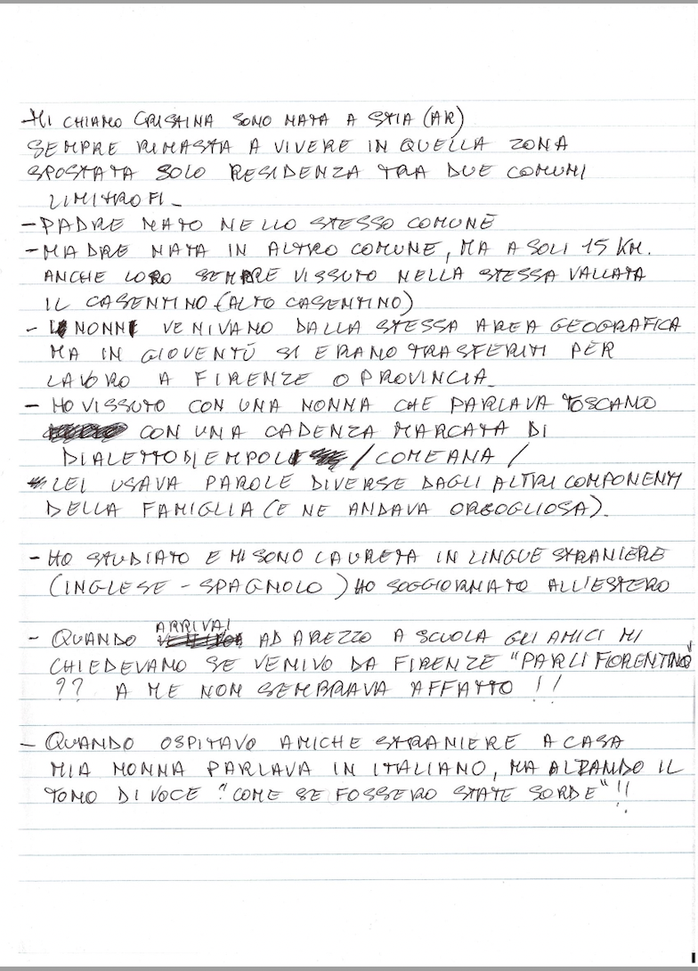
What is a linguistic autobiography?
10/10/22
Fare clic per inserire nome evento

Slide 4
Mi chiamo Silvia, sono nata a Firenze nel 1973. La mia residenza è sempre stata a Calenzano, ma ho lavorato nelle università di Perugia, Pisa, Macerata, Siena, Firenze.
La mia è stata una famiglia monolingue: mio padre di Calenzano, con un dialetto ‘rustico’ (conigliolo, figliolo, usi analogici nel sistema verbale, p.e. ‘tu dissi’), mia madre di Quarrata, provincia di Pistoia, con una parlata più borghese e corretta.
La percezione della diversità comincia a tavola, da piccina, quando mia mamma chiama “loti” quelli che mio padre chiama “diosperi”. O quando lei dice “coppa” per quello che mio padre chiama “soprassata”.
My name is Silvia, I was born in Florence in 1973. My residence has always been in Calenzano, but I have worked in the universities of Perugia, Pisa, Macerata, Siena, Florence .
Mine has been a monolingual family: my father from Calenzano, with a 'rustic' dialect (conigliolo, figliolo, analogical uses in the verbal system, e.g. 'tu dissi'), my mother from Quarrata, in the province of Pistoia, with a more bourgeois and correct dialect.
The perception of diversity begins at the table, as a child, when my mother calls what my father calls 'diosperi' 'lotuses'. Or when she says 'coppa' for what my father calls “soprassata”.
10/10/22
CLARIN Annual Conference, Prague

Slide 5
A template example
Family members and personal data
Family linguistic background
Family linguistic situation
Family and school attitudes and behaviors
Meeting with linguistic diversity
Formal and informal language learning
Personal evaluation of language learning in and out of school
Ability to perceive different linguistic varieties, social evaluation of accents, stigma and stereotypes towards accents, varieties, languages, etc.
04/10/22
CLARIN Annual Conference, Prague
Notes:
Family members and personal data (place of birth, eventual relocations, etc.);
Family linguistic background: L1 of the grandparents, L1 of the parents;
Family linguistic situation: parents and grandparents’ linguistic preferences (which language spoken with whom and when); which languages are used for ordinary communication between family members (with children, with the rest of the family); family choices in linguistic education (which language is taught to children); which language is spoken at home; which other varieties are used at home, and for what need (communicative, expressive, affective needs, identity stances, etc.);
Family and school attitudes and behaviours: repression of non-standard varieties; are any specific varieties preferred to other varieties? Are there any disfavoured languages? Are there any forbidden languages used in secret between friends or family members?
The template (and the terminology used) can be adapted depending on the age, educational background and other characteristics of those involved. In any case, linguistic autobiographies are deeply personal texts that outline the writers’ own thoughts and feelings, giving them the possibility for spontaneous expression.

Slide 6
Why linguistic autobiographies?
Highly versatile tool: easily collectable without specific skills or academic knowledge
as a pedagogical tool:
  for students, to develop their metalinguistic and meta-pragmatic abilities
  for students, to narrate their multilingual selves and help make their languages more visible
  for students, to develop awareness of cultural and linguistic diversity, to learn about the social value of languages, to understand mechanisms of stereotyping and linguistic discrimination.
  for teachers, to gain access to the students’ linguistic learning process, practices, and motivation and they can discover students’ learning practices, and reasons for studying languages, as well as their needs and expectations.
as a research tool:
  to help linguists in gaining access to language ideologies and attitudes towards language varieties
04/10/22
CLARIN Annual Conference, Prague
Notes:
For researchers:
For those who are interested in the sociology of languages, linguistic autobiographies can also provide unique information about informal language-learning opportunities and the different values that speakers attach to different types of multilingualism.

Slide 7
The societal potential
For policy makers and stakeholders:
  how ideologies about languages can influence the linguistic behavior of speakers.
  students’ motivation for language learning, thus developing specific school curricula for addressing students’ communicative needs.
04/10/22
CLARIN Annual Conference, Prague

Slide 8
Towards a new resource for CLARIN
A multilingual collection of linguistic autobiographies
  Italy and Norway
  different educational settings (L1 and L2 speakers)
  Italian corpus: ca. 200 linguistic autobiographies collected during university linguistic courses, ca. 50 autobiographies of secondary school students and ca. 40 autobiographies of secondary school teachers.
Encourage the production of new material.
  A multilingual template will be made available to the CLARIN community to facilitate the collection of linguistic autobiographies.
Uncover eventually already existing material and enhance reusability
04/10/22
CLARIN Annual Conference, Prague
Notes:
La nostra intenzione è di costruire una nuova risorsa multilingue con questo materiale. We know that linguistic autobiographies are already used in school and university settings?

Slide 9
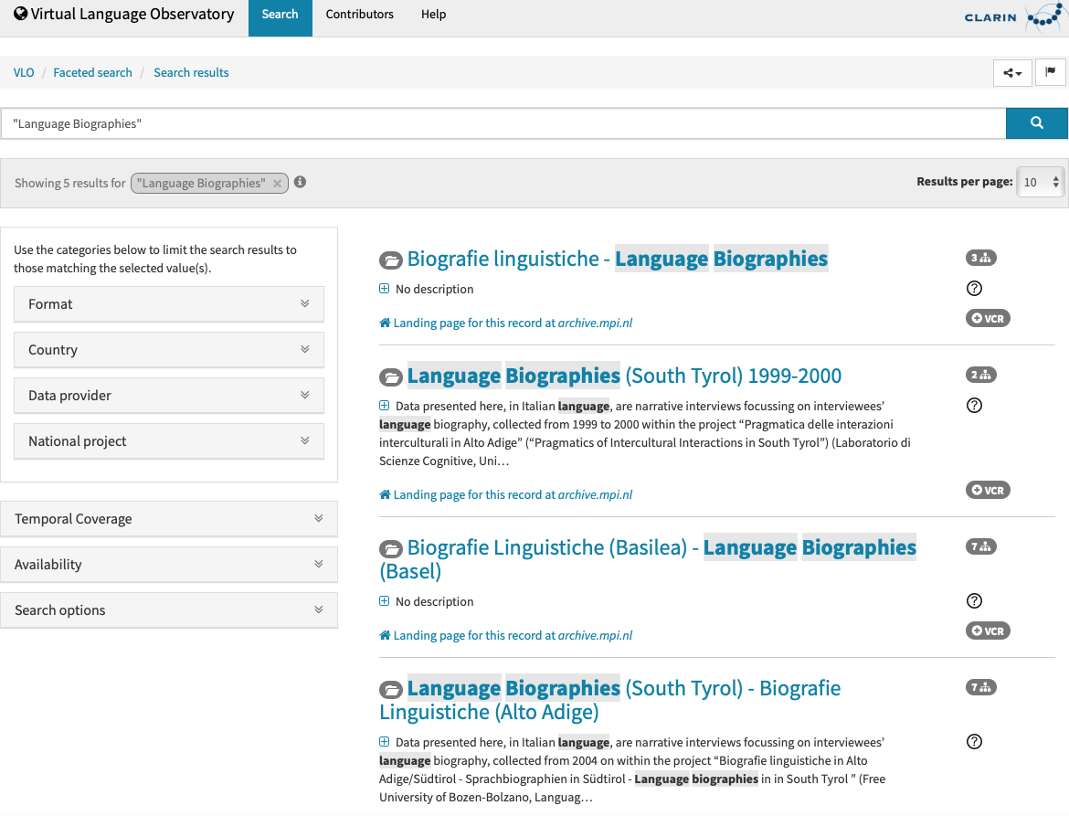
A new resource family on linguistic reflexivity
04/10/22
CLARIN Annual Conference, Prague
Notes:
non solo corpus plurilingue. sappiamo che c’è tanto materiale eterogeneo. Concetto iperonimico che ricopra tutti i concetti. Riflessività linguistica. anche immagini.
Silhouettes come biografie o autobiografie.
There is a wealth of heterogeneous material covering linguistic reflexivity:
Oral interviews and their transcriptions
Textual/Visual Maps
…. ?

Slide 10
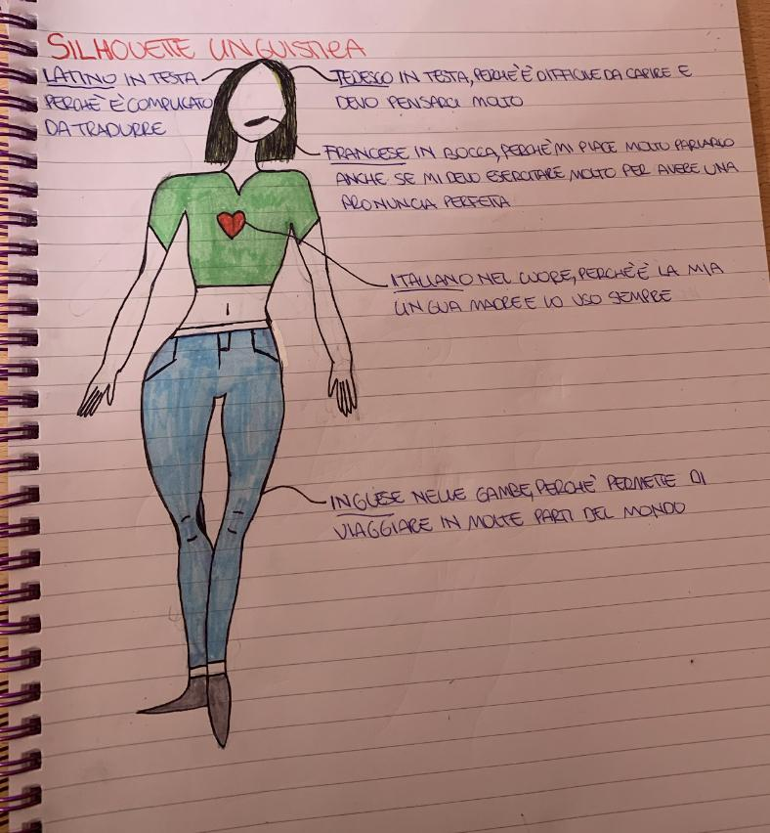
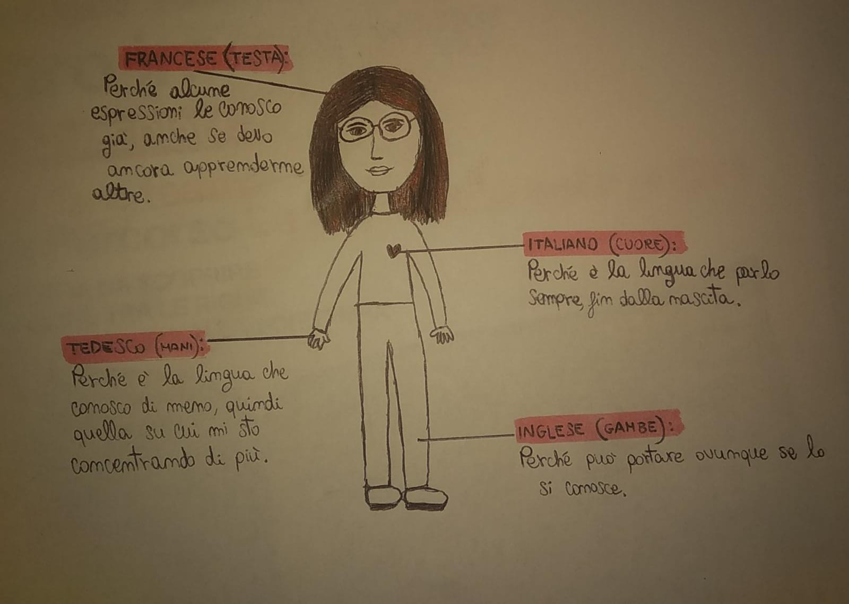
A new resource family on linguistic reflexivity
CLARIN Annual Conference, Prague
04/10/22
Fare clic per inserire nome evento
Notes:
non solo corpus plurilingue. sappiamo che c’è tanto materiale eterogeneo. Concetto iperonimico che ricopra tutti i concetti. Riflessività linguistica. anche immagini.
Silhouettes come biografie o autobiografie.
There is a wealth of heterogeneous material covering linguistic reflexivity:
Oral interviews and their transcriptions
Textual/Visual Maps
…. ?

Slide 11
Towards a new resource family
Appropriate metadata aimed at
  exhaustiveness, to maximize impact on traceability
  modularity, to enable the description of different resources (essays, writings, etc.)
  increasing comparability with similar resources in genre and/or content.
04/10/22
CLARIN Annual Conference, Prague
Notes:
non solo corpus plurilingue. sappiamo che c’è tanto materiale eterogeneo. Concetto iperonimico che ricopra tutti i concetti. Riflessività linguistica. anche immagini.
Silhouettes come biografie o autobiografie.

Slide 12
Potential applications
Collection and curation of such material would offer an invaluable resource:
  as teaching material to raise awareness of heritage languages, accentism and glottophobia.
  to help teachers to better understand the most used and known languages in the classrooms.
  as a tool to verify the pervasiveness of the concept of linguistic error and deviation in describing linguistic repertoires among pupils, students, and teachers.
Provide valuable quantitative and qualitative data to researchers interested in a variety of topics – such as language attitudes, language and migration, multilingualism and language contact.
Help policymakers in designing linguistic policies more consistent with the different linguistic landscapes which are truly present in different European schools and universities.
04/10/22
CLARIN Annual Conference, Prague

